Slide 1
Ocean Life

Slide 2
Look at the picture on the next slide and write down everything you know about the ocean and everything you want to learn about the ocean. Share your thoughts with the class.

Slide 3
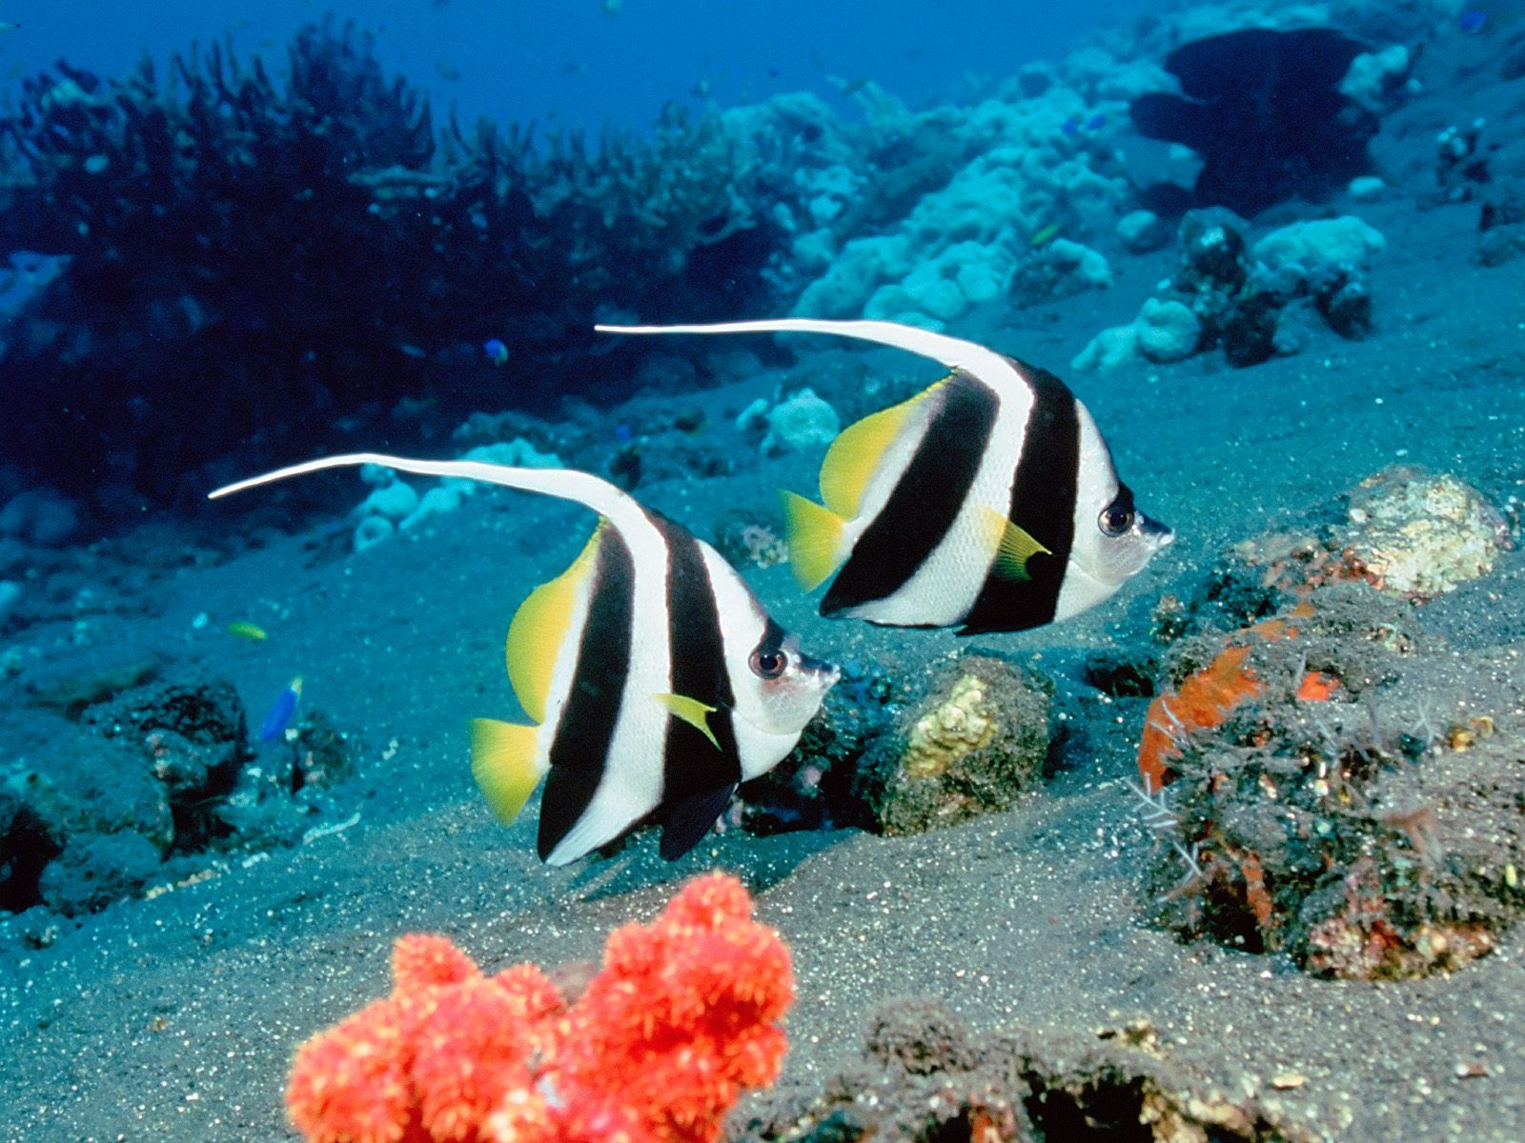

Slide 4
How do scientists learn about the ocean?
Watch this video https://www.youtube.com/watch?v=mjzVCt3Om-M to find out.

Slide 5
The ocean is divided into zones.

Slide 6
Descriptions of Zones

Slide 7
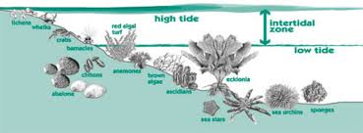
Intertidal Zone
The intertidal zone is the narrow ocean margin between the high tide mark and low tide mark.

Slide 8
Intertidal Zone
Watch this video.
The video can also be found at http://www.youtube.com/watch?v=u64ppKBY3cM. As you watch the video, answer the following questions:
1. How do tides form? Where is the intertidal zone located?
2. How are animals in the intertidal zone different from other species?
3. Why would an algae be covered with slime?

Slide 9
Intertidal Animals
Talk with a partner to determine the adaptations the following animals use to survive in the intertidal zone.
Crabs
Mussels
Seaweed

Slide 10
Animal Adaptations
Crabs move around and seek cover in the sand or in between rocks.
Mussels attach themselves to rocks and close their shells to keep from drying out during low tide.
Some seaweeds dry out at low tide but are able to regain moisture at high tide.

Slide 11
Estuaries
Watch this video https://www.youtube.com/watch?v=PRYpw2aKRTo and defend or refute the following quote, providing evidence from the video to support your claim:
“Estuaries are places where magic happens. Most ocean life owes gratitude to an estuary.”

Slide 12
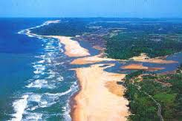
Estuaries

