Slide 1
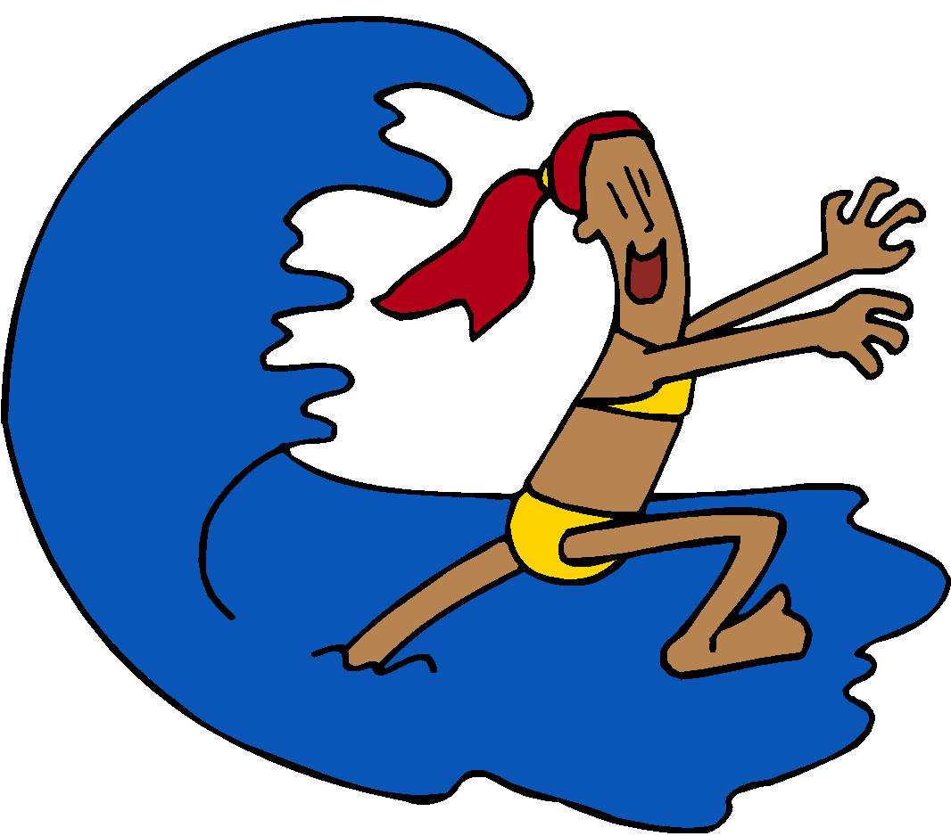
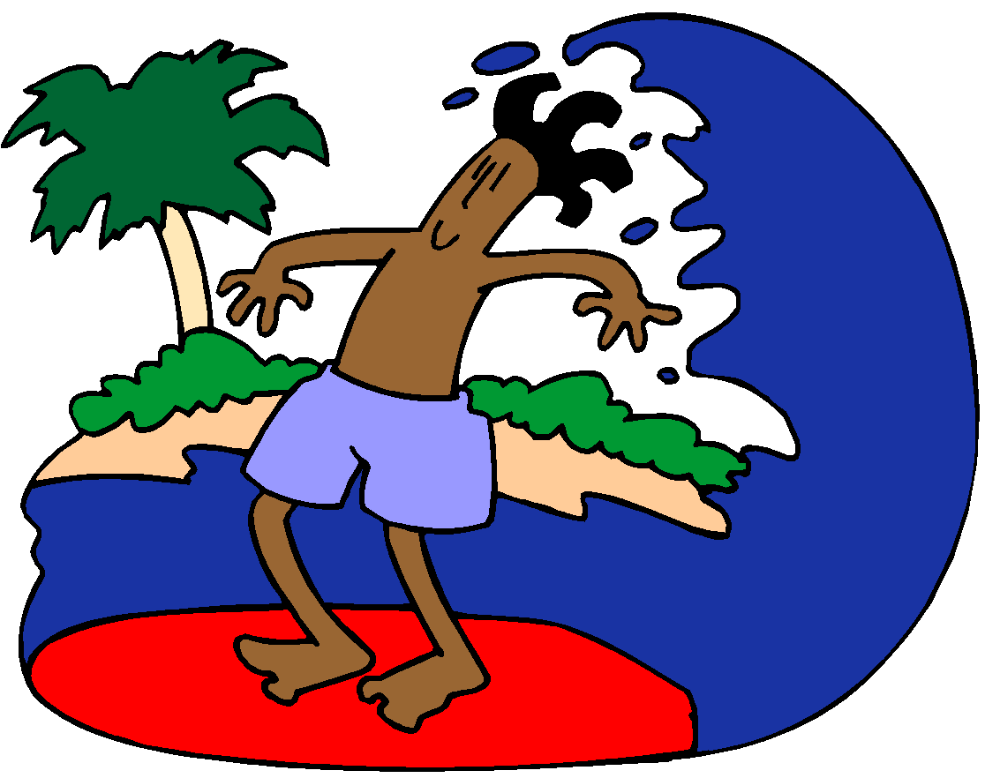
Ocean Currents

Slide 2
What is a current?
Current – A large stream of moving water that flows through the oceans.
2 Types of Currents:
Surface Currents
Deep Currents

Slide 3
Surface Currents
What are currents at the surface of the ocean are driven by?
Wind

Slide 4
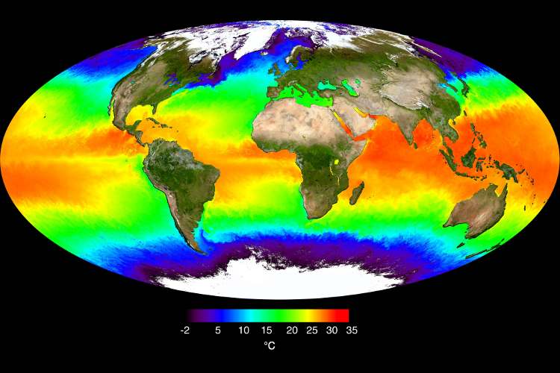
Ocean Temperatures at the Surface
Surface temperatures vary by location and season.
Surface temperature is warmer near the equator than near the poles.

Slide 5
How do currents affect the climate?
The surface currents warm or cool the air above it, and thus changes the climate.
Question: Alaska and Northern Europe are at the same latitudes. Why is it then that Alaska has a much colder climate than Northern Europe?

Slide 6
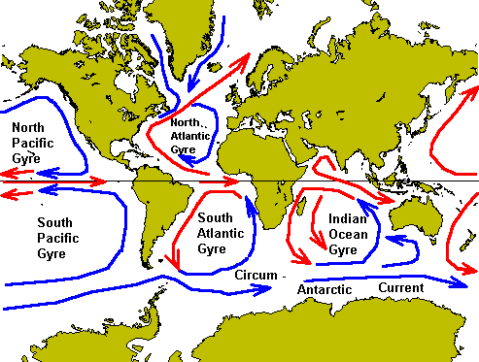

Slide 7
Deep Currents
Cold water is moved across the ocean floor, deep below the ocean’s surface.
What causes deep currents?
Differences in Density

Slide 8
Upwelling
Upwelling – The movement of cold water upward from the deep ocean.
What causes an upwelling?
When strong winds move warm surface water, then this allows the cold water to rise up and replace the warm water.

Slide 9
Upwelling
Upwelling brings up minerals and nutrients.
This supply of nutrients allows for many fish and ocean animals to live in upwelling zones.

