Slide 1
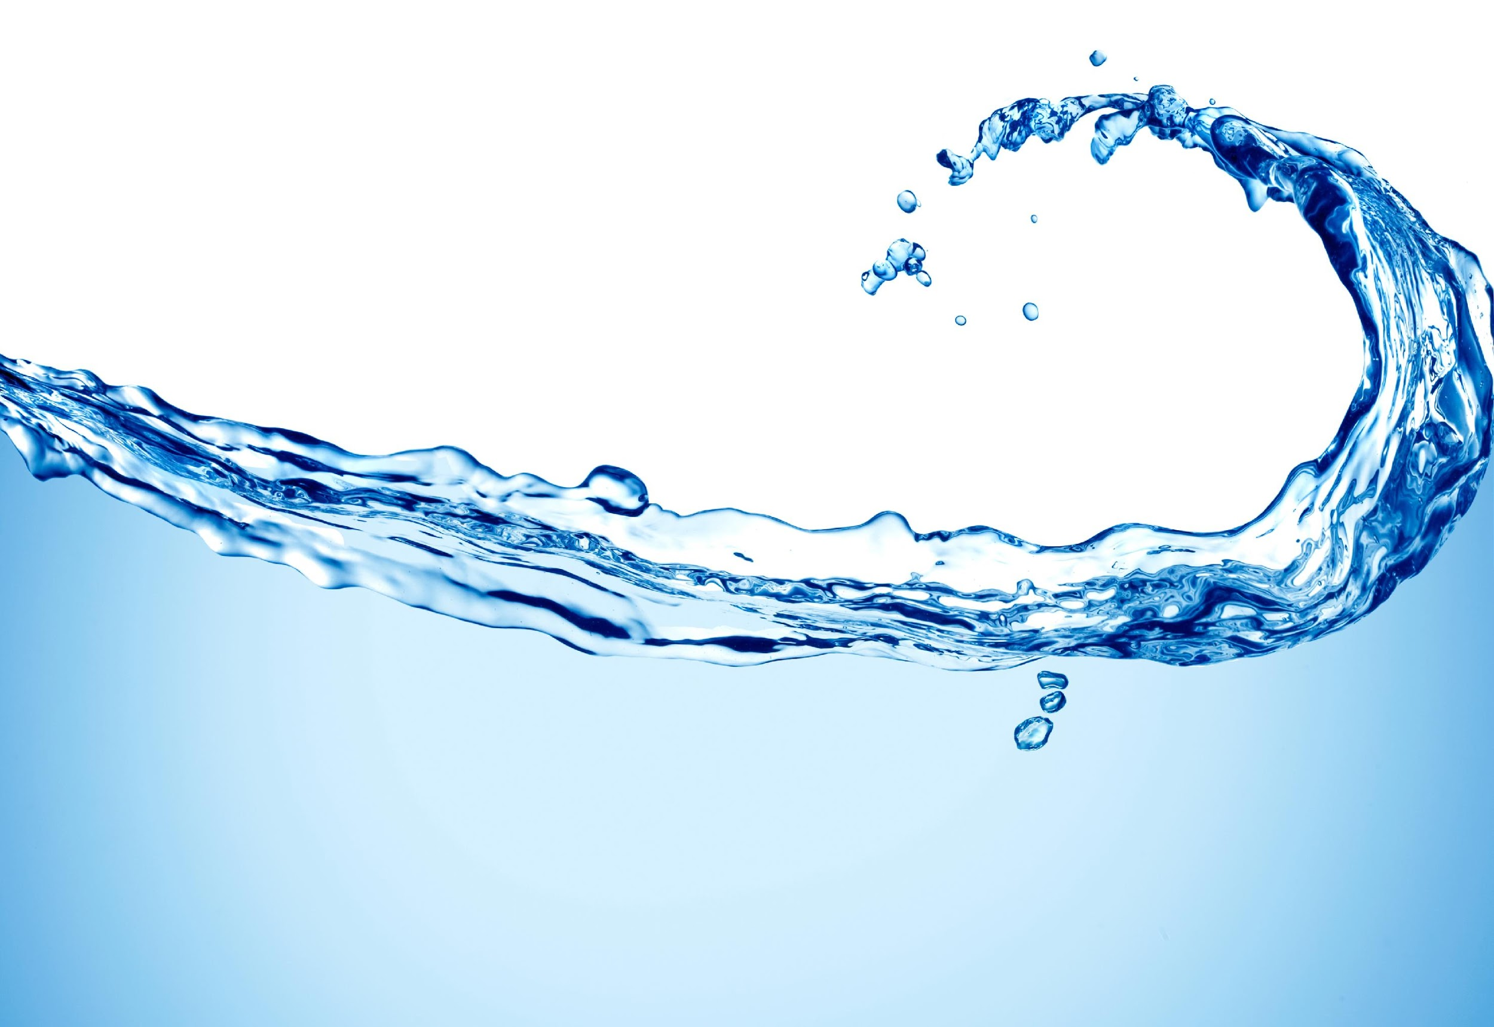
Notes: Water Quality

Slide 2
What is water quality?
Water quality: describes the chemical, physical, and biological characteristics of water. Water quality is also described by what the water will be used for:
Potable water: water that is safe to drink.
Safe water: water that is safe to use for bathing or cleaning.
The Environmental Protection Agency (EPA) determines how much of a contaminant is allowed in water for it to still be considered safe and/or potable.

Slide 3
What are water quality standards?
The Environmental Protection Agency (EPA) sets “maximum levels” for 90 of the most common contaminants.
Local and regional agencies also help monitor water quality.
Standards outline the goals for a body of water by identifying its uses, establishing how to protect those uses and establishing provisions to protect and preserve the water bodies in the long term.

Slide 4
What are water quality indicators?
Water quality indicators are things that we test to determine the health of a water system (river, lake, ocean, etc.).
We can measure physical, chemical, or biological indicators.
Physical: temperature, turbidity, movement
Chemical: pH, dissolved oxygen, nitrates, salinity
Biological: bioindicators (what organisms live in and near the water?)

Slide 5
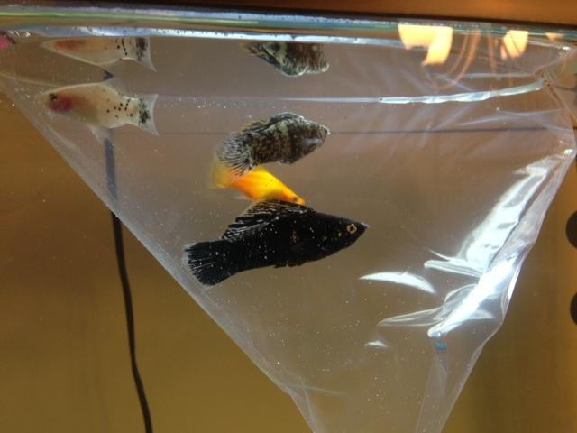

Slide 6
Temperature
Important for life—most organisms have preferred water temperature ranges that they live in.
Affects solubility of gases (like Oxygen) and minerals. Colder water dissolves less gas (cold=less oxygen)
Affects density

Slide 7
pH
pure water has a pH of 7
too acidic or too basic causes problems—can damage living things
close to 7 (between 6.5 and 9.0)= clean and healthy
pH also affects how other minerals or contaminants behave. Some chemicals may become more toxic in acidic water!

Slide 8
Dissolved Oxygen (DO)
Oxygen can be dissolved in water. Many living things require oxygen to live.
Can be depleted by pollution
Healthy levels are between 4mg/L and 12mg/L
Normally oxygen in water gets there through diffusion with the air and as a waste product of photosynthesis by aquatic plants.
Dissolved oxygen in surface water is used by all forms of aquatic life; therefore, it is measured to assess the "health" of lakes and streams.
When dissolved oxygen levels in a body of water decline, sensitive animals may move away, weaken, or die.
High DO levels in potable water usually make it taste better.

Slide 9
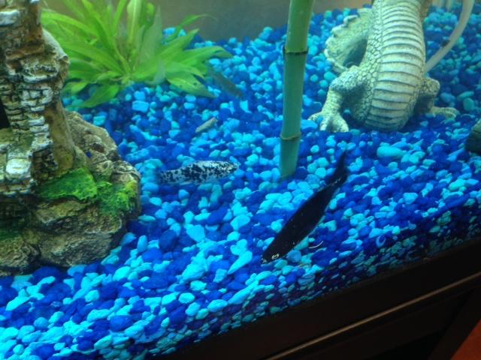

Slide 10
Nitrate and Phosphorous Concentration
Plants need nitrates and phosphorus to grow
Increased nitrates = increased algae growth. Too much algae growth can lead to less oxygen in the water and kill other organisms
High levels can be toxic to humans, especially infants. Healthy levels are below 1mg/L
The major sources of nitrates in surface water include runoff contaminated with fertilizers, septic tank leakage, and sewage. Phosphates, on the other hand, usually enter waterways from human and animal waste, laundry, cleaning, and industrial waste.

Slide 11
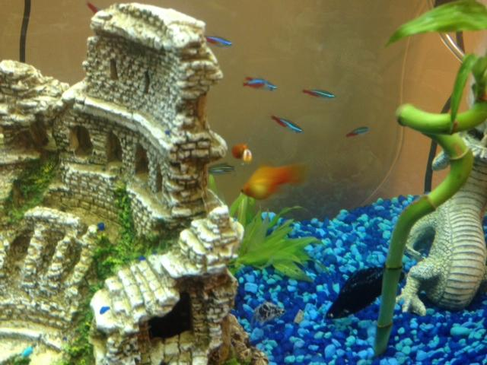

Slide 12
Turbidity
How clear the water is—more sediment = less clear = more turbid
All water has some turbidity
Humans need pure, clear water for everyday tasks.
Turbidity is caused by erosion, runoff, and pollution.
Turbid water can contain sand, silt, clay, plankton, industrial wastes, sewage, lead, and bacteria/viruses.
Too much sediment can be harmful to living organisms—can smother fish eggs, change temperature; many fish and other organisms need clearer water to spot their prey; decreases light penetration, which is harmful to plants that use sunlight for photosynthesis.
In bodies of water, high turbidity can lead to increased water temperatures, low dissolved oxygen, and even physical problems for aquatic organisms.

Slide 13
Bioindicators
Bioindicators: Organisms that we can look at to help determine the health of a body of water.
Scientists can look at macroinvertebrates—stoneflies, worms, mosquitoes, beetles, etc. Macroinvertebrates are easy for people to collect and identify.
The presence, condition, and numbers of the types of fish, insects, algae, plants and other aquatic life provide accurate information about the health of a water system. Because many macroinvertebrates are sensitive to pollution in water, they are a good indicator of whether or not a body of water is livable. Good water quality is indicated by a variety of macroinvertebrates. Poor water quality is indicated by a few of one type of macroinvertebrates in one place.
They show cumulative effects of a variety of stressors (pollution, pH, temperature, nitrates)

Slide 14
