Slide 1
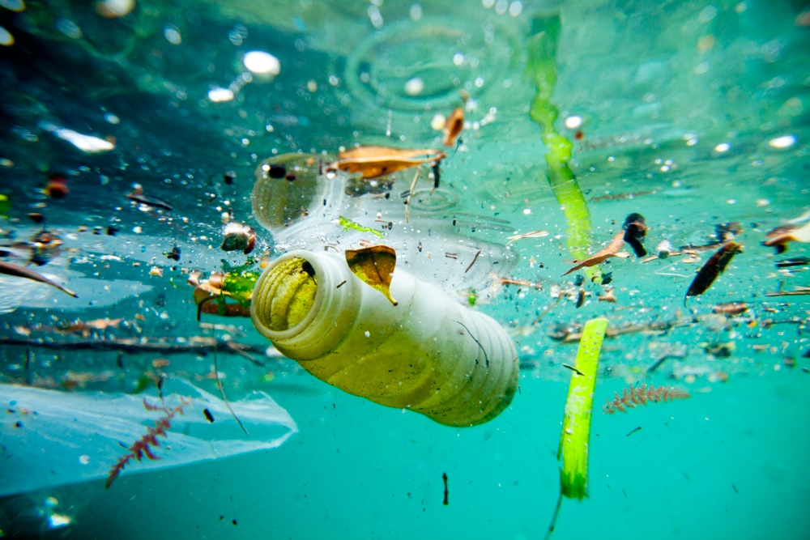
Water Pollution and
Conservation

Slide 2
How does freshwater support life?
All living things need fresh water to live.
Without water, we can live for only a few days.
Necessary for: agriculture, fishing, drinking

Slide 3
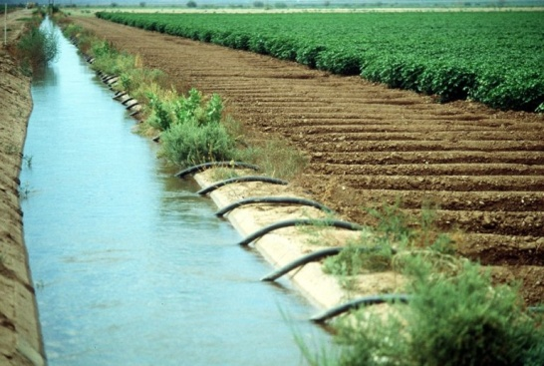
How is freshwater used for human activities?
In US, 70% of water use goes to farming/agriculture.
Irrigation: the process of supplying water to grow crops
In some places, it does not rain enough; need water from elsewhere to grow crops.
Irrigation systems: Water flows into canals → fields
Reduces evaporation
Industries use water.
Cars→ washing, cooling off hot metal
Transportation by rivers/lakes to transport goods

Slide 4
How is freshwater used for human activities?
Fisheries and aquaculture
Raising fish requires water
Aquaculture: the science and business of raising and harvesting fish in a controlled situation (fish farms)
+ →gives us fish, cheaper, less dangerous than fishing
- →causes pollution to rivers/lakes, can harm wild populations

Slide 5
How does water produce energy?
Hydroelectric power: Water runs through dams built across rivers and turn turbines to produce power.
Dam: structure that holds back and controls the water in a river
Dams change the landscape and shape of a river. It floods the area behind the river.
Reservoir: the lake/flooded area behind a dam
Dams and locks help boats move down a river or canal
Lock: section of waterway, closed off by gates; water level raises and lowers
Dams can cause flooding and interrupt breeding and migratory patterns of fish.

Slide 7
What is Pollution?
Water might have impurities (called pollution).
Concentration: amount of substance in another substance
Measured in parts per million (ppm)
Low concentration = ok for humans
High concentration = dangerous, needs to be treated
Water pollution comes from many sources.
Point-source pollution: pollution that enters water from a known source
Easy to spot; laws can stop it
Nonpoint-source pollution: pollution whose source is hard to find
Ex. Runoff from farms/homes/cities
Difficult to stop; causes most pollution

Slide 8
What causes pollution?
Agriculture: runoff containing waste and fertilizers
Industry: toxic waste, chemical leaks, aquaculture and overfishing
Homes: putting chemicals down the drain, pesticides/fertilizers

Slide 9
How can we reduce pollution?
More pollution means less water we can use
Ways to reduce pollution in:
Industry and transportation
Maintain pipes so chemicals don’t leak out
Inspect trucks, ships, and planes
Reduce toxic waste / use less materials
Agriculture
Use less pesticides
Keep animals away from streams and lakes
Home
Recycle!!
Don’t put chemicals down the drain
Use less pesticides, fertilizers, weed killers

Slide 10
How do we treat water?
Even clear water may contain odorless, tasteless, and colorless harmful contaminants. Water must be tested for specific contaminants such as bacteria, nitrates, arsenic and others.
Natural supplies of potable (drinkable) water are rare, and there is not enough to meet human needs. Because of this, we have developed water treatments that clean water so that it can be used for a particular purpose.
Drinking water treatment requires some basic steps:
Water collection
Coagulation, during which lime and alum are added to the water, causing particulates to clump together.
Next, the water is shaken to form larger clumps, called flocs.
During the sedimentation process water stands for approximately 24 hours, which allows the clumps to settle to the bottom.
The water is then filtered, disinfected (usually with chlorine) and aerated (mixed with oxygen).
The substances removed during the drinking water treatment process include suspended solids, bacteria, algae, viruses, fungi, minerals, and chemical pollutants.

Slide 11
What is the difference between a sewage system and a septic system?
Sewage system: LARGE system that a city or town uses to treat water.
use sewage pipes
Septic system: SMALL system that a business or a home uses to treat water.
common in rural areas

Slide 12
What are water shortages?
Not everyone has access to clean, safe water. Freshwater shortages around the world are a growing problem.
Physical Scarcity: there is very little freshwater in a given area.
Economic Scarcity: a group of people cannot get freshwater because it is too expensive.
Water scarcity is a problem even in the United States, where water levels are dropping and some lakes and rivers may dry up.
Water shortages are a global problem.
More people = more water needed
Drought: a long period of low rainfall
Can destroy crops, cause fires, etc.
Overuse can cause water shortages.
Farming uses 2/3 of our available water.
We use water too quickly—it takes a long time for it to be replaced!

Slide 13
How can we conserve water?
One person uses about 168 liters/day of water
Population increase = more people = use more water
Aquifers are drying up→can take thousands of years to fill it back up
People can conserve water in 3 ways.
use less water (shorter showers)
reuse water (for watering plants)
recycle water (treatment plants)
People can balance water needs and uses.
People use water differently.
Laws can regulate how much water we use for certain tasks (watering lawns, etc).
Areas can share and give water to needed areas, but this can increase pollution.
We need NEW sources of fresh water.
Desalination: process of removing salt from salt water
EXPENSIVE!!!
Icebergs: frozen water makes up 70% of Earth’s fresh water
We could melt them for fresh water, but towing and melting is EXPENSIVE

