Slide 1
Notes: the Ocean
2/3/14

Slide 2
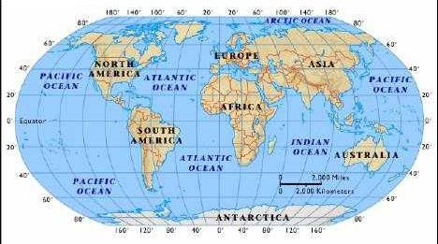
What is the Ocean?
Ocean water covers most of Earth.
97% of water on Earth is sea/salt water.
All sections of the ocean are connected.

Slide 3
Why is the ocean important?
The ocean covers most of Earth’s surface.
It is an important source of food and mineral resources.
We use it for transportation and recreation.
The ocean stores heat—water has high specific heat, so it takes a lot of energy to heat it up. Water holds on to this heat energy and stays warmer longer than the air.
The stored heat in the ocean drives much of Earth’s weather and causes climate near the ocean to be milder than climate in the interior of continents.
Ocean currents distribute energy (heat) and resources.

Slide 4
What is the relationship between density and salinity?
Ocean water contains salts and gases.
Ocean water has all 92 natural elements.
Salinity: a measure of the amount of dissolved salt contained in water
many kinds of salts in the ocean (mostly NaCl)
salt water is more dense (heavier) than fresh water.
Density: a measure of the amount of matter packed into a given volume (mass/volume)
More salt = greater density = more objects float
Ex. Dead Sea is VERY dense!

Slide 5
Salinity and Density

Slide 6
Salinity (continued)
Salinity & density vary in the ocean (different depending on where you are).
Higher salinity: cold areas where water freezes (salt does not freeze), shallow areas (more evaporation, salt does not evaporate)
Lower salinity: areas where ocean is diluted by freshwater (estuaries—where rivers meet the ocean—or where a lot of rain falls).

Slide 7
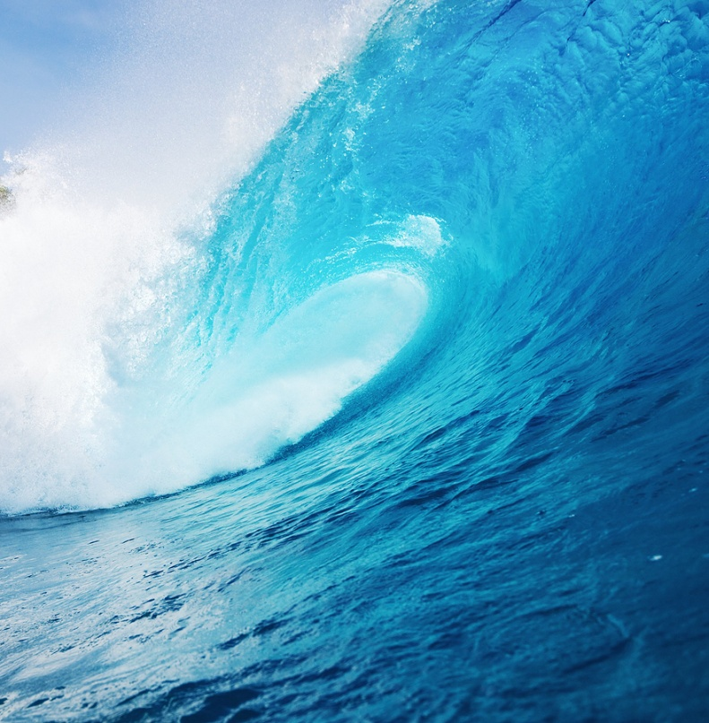
What gases are dissolved in the ocean?
Ocean water has many different gases dissolved in it, mostly nitrogen, oxygen, and carbon dioxide.
The movement of wind over the ocean and waves agitates (mixes up) the water at the surface, speeding up the exchange of gases between the ocean and the atmosphere (like shaking a soda bottle!).
Marine (ocean) plants need carbon dioxide dissovled in the water to go through photosynthesis→photosynthesis releases oxygen into the water, which is then used by ocean organisms (like fish) to go through respiration.
As atmospheric levels of gases rise, so do levels of those gases dissolved in ocean water.

Slide 8
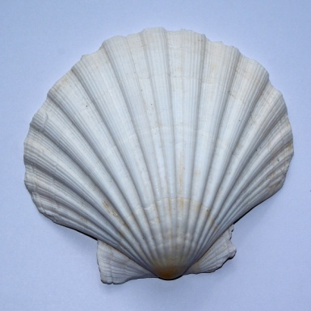
Why is carbon dioxide so important?
Carbon dioxide is one of the most important gasses dissolved in the ocean (along with oxygen!)
Some carbon dioxide stays dissolved as gas, but most reacts with water to form carbonic acid or reacts with other carbonates to form bicarbonates. This removes carbon dioxide from water.
Bicarbonates are used by many marine organisms to form calcium carbonate shells. When these organisms die, some of the bicarbonate is returned to the water, but a lot of it settles into the sea bed. This process locks up carbon that originated as carbon dioxide in the atmosphere for long periods of time.

Slide 9
What determines how much gas can be dissolved in seawater?
Cold water holds more gas than warm water.
Seawater with low salinity holds more gas than high salinity water.
Deep water, which has a high pressure, holds more gas than shallow water.

Slide 10
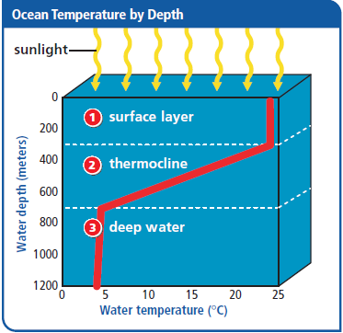
What is the temperature of the ocean?
Ocean is divided into 3 layers based on temp.
surface layer→warmest, varies with depth
warm water is less dense, stays on top
thermocline→temperature drops with depth
deep water→ cold all year long, barely above freezing
Draw:

Slide 11
How does the ocean affect our climate?
The ocean is an important factor in the global climate because it collects and moves water, heat, and carbon dioxide
These components are constantly exchanged between the atmosphere and hydrosphere (water on Earth)
Ex: evaporation: water goes from the hydrosphere to the atmosphere
Because the ocean can store so much heat, seasons occur later than they would and air above the ocean is warmed.
Heat energy stored in the ocean in one season will affect the climate almost an entire season later.

Slide 12
Climate (continued)
Air temperatures around the world are regulated by movement of heat in the ocean.
Most heat in the ocean is stored in the top 2 meters because seawater has a high density and high specific heat—this allows the ocean to store a lot of heat.
The ocean can then buffer changes in temperature by storing and releasing heat.
Evaporation cools ocean water (just like sweat cools your body), which cools the atmosphere. This is more important near the equator, where there’s a lot of evaporation, than near the poles.

Slide 13
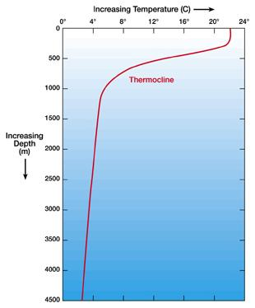

Slide 14
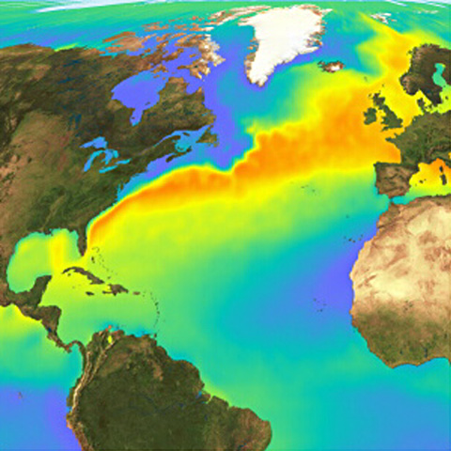
Climate (cont.)
Moving air (wind) causes moving water (currents).
Surface currents: help distribute heat around the globe
Ex. Gulf Stream current causes the climate in Great Britain to be mild, whereas at the same latitude in Canada, there would be polar bears.
A change in surface currents can cause a HUGE change in weather patterns.
no wind = no surface currents = different climate/weather
El Niño
Pacific Ocean: wind normally blows west (←), some years it’s not as strong
causes changes in weather around the world; lasts 12-18 months

Slide 15
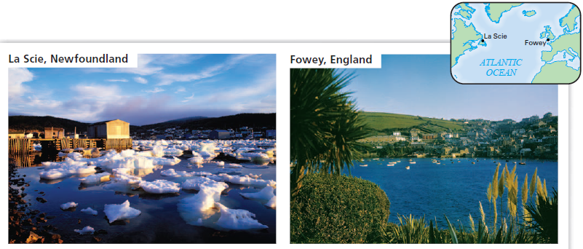

Slide 16
How does wind affect the ocean?
Wind causes waves:
A wave is an up-and-down motion along the surface of a body of water.
Moving air drags across the water’s surface and gives energy to the water, causing waves.
Wind blows over the ocean, causing surface currents.
carry warm water away from the equator & cold water away from the poles
Earth’s rotation makes them spin in circles (clockwise in N. Hemisphere, counterclockwise in S. Hemisphere)
Ocean current: mass of moving water; many currents in the ocean distribute heat and nutrients
Currents move water, waves move energy.

Slide 17
What are deep ocean currents?
Deep currents are caused by differences in density (due to temp, salinity, etc)
Downwelling: water moving from the surface DOWN to the bottom
carries oxygen down
allows animals to live in the deep ocean
Upwelling: water moving UP to the surface
Occurs when warm surface water is blown offshore by wind. This allows the cold water at the bottom of the ocean to rise.
carries nutrients up
large numbers of animals gather in areas where upwelling occurs because of the availability of nutrients.

Slide 18
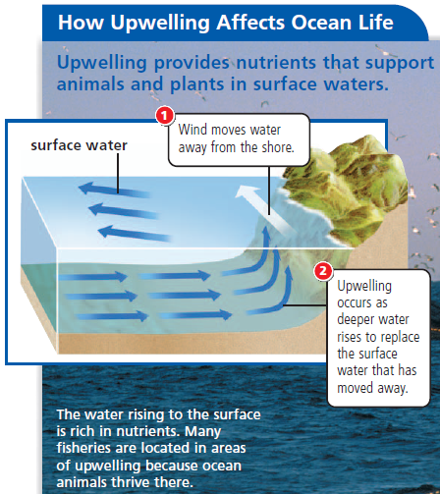

Slide 19
What are some effects of waves?
Waves cause currents near the shore.
The drifting of swimmers down the beach is due to a longshore current, which moves water parallel to the shore.
Occurs in places where waves meet the land at an angle instead of head-on.
The movement of waves and longshore currents can build up sandbars in the waters near a shore.
Sandbars are long ridges or piles of sand that can form parallel to the coastline.
Water may collect behind the sandbars.
Rip currents are narrow streams of water that break through sandbars and drain rapidly back to sea.
Rip currents occur when high winds or waves cause a larger-than-usual amount of water to wash back from the shore.
Rip currents can be dangerous for swimmers
Rip currents are too strong to swim against, but they are narrow. Swimming parallel to the shore is the best way to escape a rip current.

Slide 21
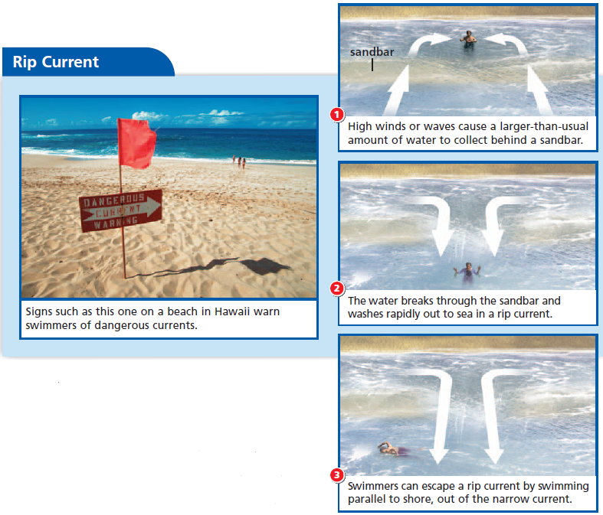

Slide 22
What are tides?
Coastal waters rise and fall each day
The water level on coastlines varies with the time of day. This periodic rising and falling of the water level of the ocean is called the tide.
The water level is highest at high tide, submerging parts of the coastline.
The water level is lowest at low tide, exposing more of the coastline.

Slide 23
What causes tides?
The gravity of the moon and the sun causes tides.
In response to the moon’s gravitational pull, Earth’s water bulges on the side facing the moon (direct high tide). Earth gets pulled toward the moon leaving a bulge of water on the side of Earth facing away from the moon (indirect high tide).

Slide 24
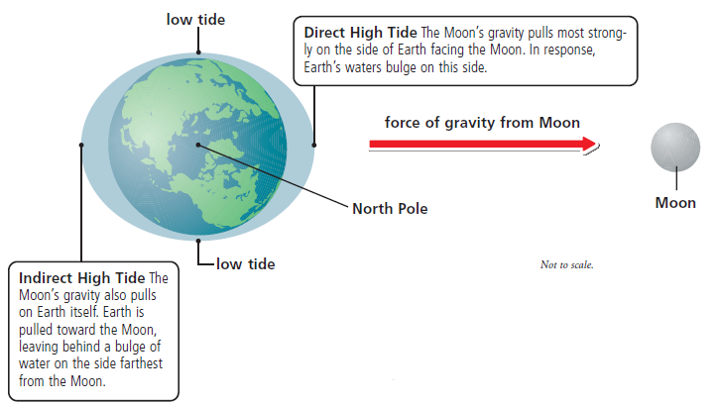
Draw: Direct/Indirect tides

Slide 25
What is a tidal range?
Some places experience higher high tides and lower low tides. The shape of the land above and below the water affects tidal ranges.
A tidal range is the difference in height between a high tide and the next low tide.

Slide 26
What are monthly tides?
The moon is the main cause of tides, but the sun affects tides too.
Twice a month—at the new moon and the full moon—the moon, Earth, and sun line up. The gravity of the sun and the gravity of the moon combine to pull Earth’s waters in the same direction. The result is an extra-high tidal bulge and an extra-low tidal dip, called a spring tide.
During first and third quarter moons, the sun and moon are not lined up with Earth. The gravity of each pulls from a different direction. The result is a smaller tidal bulge and tidal dip, called a neap tide. During a neap tide, high and low tides are less extreme.

Slide 27
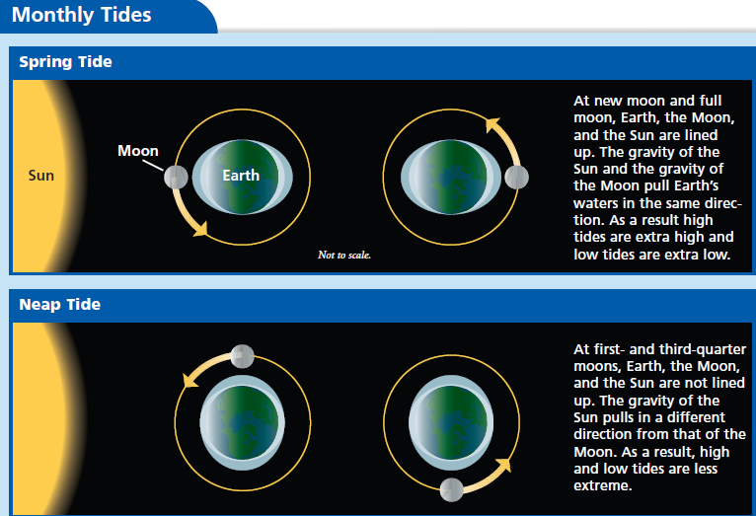
Draw: Spring/Neap tides

Slide 28
What is a tidal dam?
Tides can be used to generate electricity.
A tidal dam is a dam built near a coast in the path of tidal waters.
How tidal dams work:
Dam’s gates are open as the tide rises.
When tide lowers, gates close, trapping water.
At low tide, gates open and water rushes out, turning turbines and making electricity.
Benefits: renewable energy, less pollution.
Costs: can only be done in a few places, blocks paths of fish and can hurt marine life.

Slide 29
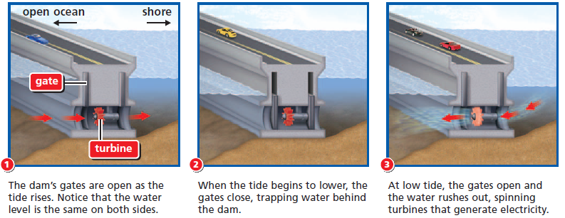
Tidal Dam

