Slide 1
Population Dynamics Notes
2/27/14

Slide 2
What is an ecosystem?
Ecosystems are complex systems that include both biological communities (biotic factors) and physical components (abiotic factors).
Organisms interact with both other living (biotic) and nonliving (abiotic) factors in the environment.
Structure:
Organisms of the same species form populations, different populations interact to form communities, communities live within an ecosystem, and all of the ecosystems on Earth make up the biosphere.

Slide 3
How do ecosystems change?
Ecosystems are dynamic, meaning they change over time. Changes in any biotic or abiotic factor can lead to shifts in all of an ecosystem’s populations.
Biodiversity: the variety of species found in an ecosystem (can be terrestrial—land—or marine—ocean ecosystem)
Biodiversity is often used to tell how healthy an ecosystem is.

Slide 4
What is population dynamics?
Population: a group of organisms of the same species that live in a particular area.
Population Dynamics: the study of why populations change and what causes them to change.
Populations go through three stages
Growth: population size is increasing
Stability: population size is constant (the same)
Decline: population size is decreasing
Carrying Capacity: the maximum number of individuals an ecosystem can support

Slide 5
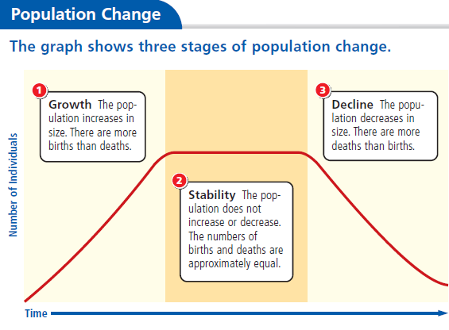

Slide 6
What four characteristics define a population?
Four characteristics define a population
Population size: number of individuals in a population at a given time
Population density: measure of the number of individuals in a certain space at a particular time
Population Spacing: clumped (organisms form groups within a habitat—gather around resources), uniform (organisms live at a distance from each other—become evenly spaced; think of trees in a forest), random (live no matter where other individuals are living)
Age Structure: postreproductive (organisms can no longer reproduce—too old), reproductive (organisms are capable of reproduction), prereproductive (organisms not yet capable of reproduction—too young)

Slide 8
How do populations change?
Scientists can predict population change based on those four characteristics
Population growth is limited.
4 types of change with population dynamics
Birth
Immigration: the movement of individuals INTO a population
Death
Emigration: the movement of individuals OUT of a population

Slide 9
Population change (cont.)
Population grows= birth and immigration are high
Population declines = death and emigration are high
ALL populations will eventually stop growing!
habitats can only support so many organisms

Slide 10
What are limiting factors?
Limiting factor: a factor that prevents the continuing growth of a population
Ex: Abiotic factors (non-living things like air, light, and water) and biotic factors (other organisms—competition, predation, etc.)
Density-dependent factor: a limiting factor that affects a population when density is HIGH (large population)
Ex: competition, disease, predation, parasitism
have a huge effect on population as it grows
Density-independent factor: a limiting factor that affects the population regardless of size; mostly abiotic factors
Ex. Fire, tornado, drought, temperature, pollution
Limiting factors affect ALL populations

Slide 11
What’s the difference between biotic and abiotic factors?
Abiotic factors: nonliving things in an ecosystem; may be chemical or physical.
Ex: water, oxygen, salinity, temperature, sunlight, rain
Biotic factors: all living components of an ecosystem.
Ex: bacteria, fungi, plants, animals
A change in a biotic or abiotic factor may decrease the size of a population if it cannot adapt to the change or leave the environment. A change may increase the size of a population if the change enhances its ability to survive and reproduce.

Slide 12
How do organisms interact?
Organisms in an ecosystem constantly interact. These interactions increase or limit the size of populations, maintaining the balance between available resources and those who consume them, generating stability in the ecosystem.
A stable ecosystem is one where:
The population numbers of each organism change at a predictable rate.
The supply of resources in the physical environment fluctuates at a predictable rate.
Energy flows through the ecosystem at a fairly constant rate over time.
These fluctuations in populations and resources ultimately result in a stable ecosystem.
Organisms interact through predation, competition, and symbiotic relationships.

Slide 13
What is predation?
Predation: an interaction between species in which one species (the predator) eats the other (the prey).
This interaction helps regulate the population within an ecosystem, producing stability. Changes in predator-prey populations are predictable, because at some point, prey becomes so numerous that they are easy to find.
A graph of predator-prey density over time shows the cycle of fluctuations (changes).
As the prey population increases, the predator population increases.
As the predator population increases, the prey population decreases.

Slide 14
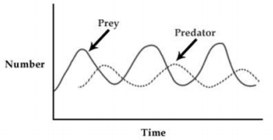
Predator-Prey graph

Slide 15
What is competition?
In any ecosystem, organisms and populations with similar requirements for food, water, oxygen, or other resources may compete with each other for limited resources.
Competition: a relationship that occurs when two or more organisms need the same resource at the same time. Competition can be among the members of the same or different species and usually occurs with organisms that share the same niche.
Niche: the role of an organism in its environment including type of food it eats, how it obtains its food, and how it interacts with other organisms.
Two species with identical ecological niches cannot coexist in the same habitat.
Competition usually results in a decrease in the population of a species less adapted to compete for a particular resource.

Slide 16
What is a symbiotic relationship?
A symbiotic relationship exists between organisms of two different species that live together in direct contact.
If one or the other symbiotic organisms changes, both organisms are affected and fall out of balance.
Symbiotic relationships include parasitism, mutualism, and commensalism.

Slide 17
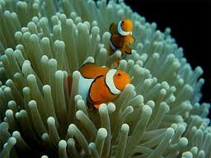
Clownfish live in a symbiotic relationship with anemones. Clownfish protect the anemones, and they eat food that gets trapped in the anemone.

Slide 18
What is parasitism?
Parasitism: a symbiotic relationship in which one organism (the parasite) benefits at the expense of the other organism (the host).
Some parasites live within the host, like tapeworms, heartworms, or bacteria
Some parasites live on the outside of the host, like fleas and ticks.
Parasites harm the host, but do not usually kill the host. Parasitism that results in the rapid death of the host is bad for both the host and the parasite. The parasite needs the host to live long enough for the parasite to reproduce and spread.

Slide 19
What is mutualism?
Mutualism: a symbiotic relationship in which both organisms benefit. Because the two organisms work closely together, they help each other survive.
Ex: bacteria that have the ability to digest wood live in the digestive tracts of termites

Slide 20
What is commensalism?
Commensalism: a symbiotic relationship in which one organism benefits, but the other is not affected.
Ex: scavenger birds eating the remains of an organism that was left behind after a predator finished eating.

Slide 21
What are reproduction strategies?
Reproduction is necessary for the survival of a species.
Opportunists: species that reproduce rapidly if their population falls below carrying capacity. Produce a lot of offspring that develop rapidly (algae, dandelions, etc.)
Competitors: species with adaptations that allow them to remain at or near their carrying capacity for long periods of time. Produce fewer offspring, and they take longer to develop, but more live to adulthood (wolves, elephants, etc.)

Slide 22
What about human populations?
Human populations differ from populations of other species
Two key factors increased Earth’s carrying capacity for humans: habitat expansion and technology
First humans lived in Africa; over time, they spread over the entire planet
Humans can live in many different environments (habitats) thanks to technology—a/c, heating, shelter, etc.
Until about 300 years ago, human population grew slowly; because of disease, resources, etc., many people died before adulthood—births and deaths were high
Human population growth affects the environment: introduction of new species (accidental or intentional—harms native ecosystem), pollution, and overfishing

