Slide 1
Notes: Ocean Environments and Food Webs

Slide 2
What lives in the ocean?
95% of ocean is unexplored!
Known organisms are put into 3 groups:
  bottom dwellers—live on the sea floor/bottom (seaweed, crabs, coral)
  swimmers—swim in the ocean (fish, dolphins, whales)
  Floaters—float at or near the ocean surface (jellyfish, protists, bacteria)

Slide 3
Habitats: Intertidal Zone
Intertidal zone: habitat at edge of shoreline
  Between high and low tide marks
  Changing conditions
  At low tide
    dry, direct sunlight
    Organisms must be able to live out of water & tolerate air temp!
  At high tide
    Covered in water
    Organisms must be able to live underwater & tolerate water temp
  Tidal pools: areas along the shore where water remains at low tide.
    Plants and animals that live here must be able to survive huge changes in salinity (evaporation→salinity increases; water comes back→salinity decreases)
  Organisms have ways to survive the changing conditions (mussels close shells to keep from drying out , crabs walk or burrow to find shelter, etc).

Slide 4
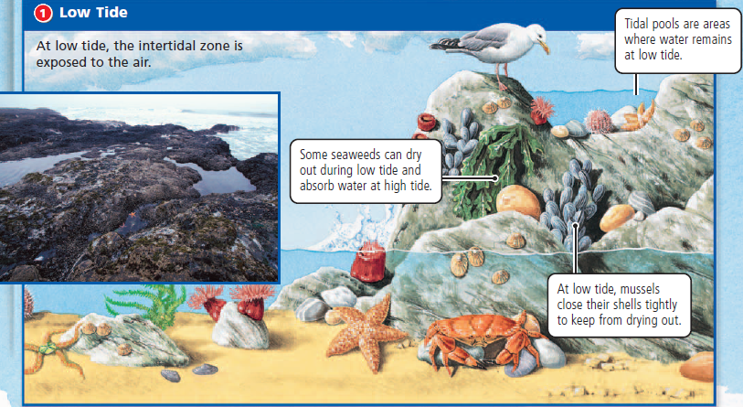
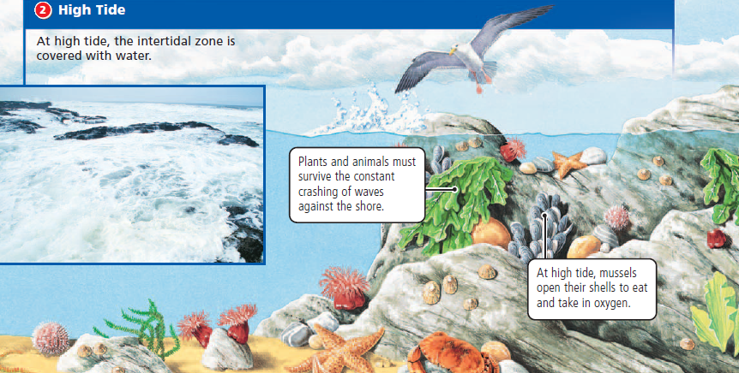

Slide 5
Habitats: Estuaries
Estuaries: where fresh water and salt water mix (where rivers meet the ocean)
  Not very salty; salinity changes with tides
  LOTS of life: extremely diverse
    All must be able to adapt to changing conditions
    Very good “nurseries” for fish: allow eggs to hatch and grow safely before migrating out to sea
  Nutrients washed in from the ocean by tides, sediment rich in nutrients washes out from rivers
    These nutrients are constantly mixed by the tide, creating very fertile conditions for plants and animals
  Estuaries are one of the most productive ecosystems on Earth.
  Estuary waters are shallow (less than 30ft deep), so sunlight reaches the bottom, allowing plants to grow.

Slide 6
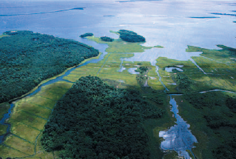
Estuaries in North Carolina
There are a lot of Estuaries in NC
The largest estuary in NC is Pamlico Sound.
  Water drains into here from a variety of places in both NC and Virginia.

Slide 7
Why are estuaries important?
They help control erosion (the washing away of land/beach) and reduce flooding.
  Sandbars buffer the impact of waves, while plants and shellfish anchor the shore against tides.
Act as an environmental filter: plants and animals here filter out pollutants from the water.
  Salt marsh plants trap some of the chemicals and pathogens carried by rivers and move them into the soil where they are neutralized.
  Oysters filter impurities out of water as they eat, collecting the contaminants in their bodies (Fun fact: oysters can filter 25 gallons of water a day)
  Bacteria eat organic matter found in sediment and release carbon dioxide and methane, preventing these gases from building up in the estuary

Slide 8
How are humans harming estuaries?
50% of people live within 50 miles of the sea; big cities are often near where rivers meet the sea.
  We harm estuaries: shrimp farms, estuaries filled in for raising crops or housing, POLLUTION
    Toxins can build up, causing environmental and health problems
  Protection from government (make laws) and local organizations and individuals (cleaning)

Slide 9
Habitats: Wetlands
Wetlands form along edges of estuaries; swampy areas
2 kinds:
  Salt Marshes: away from equator, in cooler areas; protect shoreline
    rich soil, grasses provide important habitat for fish, birds, etc.
    marsh grasses are important: have thick root systems that help hold the muddy soil together; many small fish and other animals live in the grass
  Mangrove Forests: found in tropical areas (Florida), lots of trees and shrubs, protect shoreline
Swamps and marshes take the initial impact of high winds from the ocean, soak up heavy rain and storm surges, and release the extra water gradually into rivers and groundwater supplies.

Slide 10
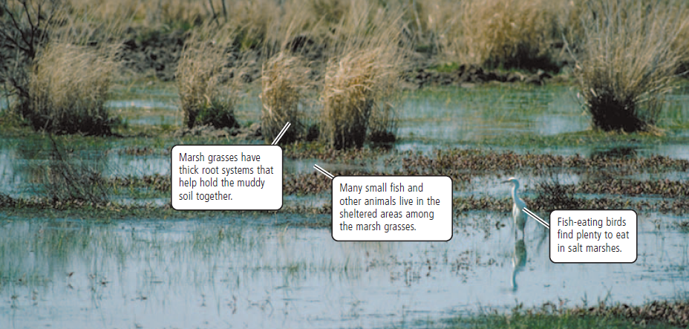
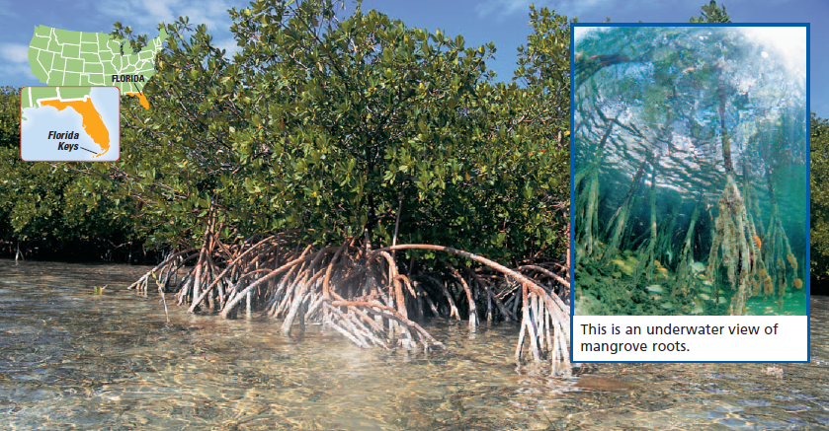

Slide 11
What are conditions like near shore?
Near shore→ warm water, shallow, temperature and salinity constant, nutrients
Waters near shore support many life forms.
  Most life in water lives near shore
  2 important habitats: Coral Reefs and Kelp Forests

Slide 12
Habitats: Coral Reefs
Found in warm, tropical areas
limestone deposits formed by coral (ant-sized organisms that produce a hard limestone covering that remains after they die—new corals then grow on top of the shells of dead ones)
coral rely on algae for food: algae live inside coral & make food
only in nutrient-rich, sunlit waters (algae need sunlight to make food)
LOTS of life (25% of ocean species): Some species use reef for shelter, some eat corals or seaweed that grow on corals
Endangered habitats due to pollution
  Coral bleaching: pollution or extreme temperatures (too hot or too cold) kill the algae that live in the coral—coral turns white)

Slide 13
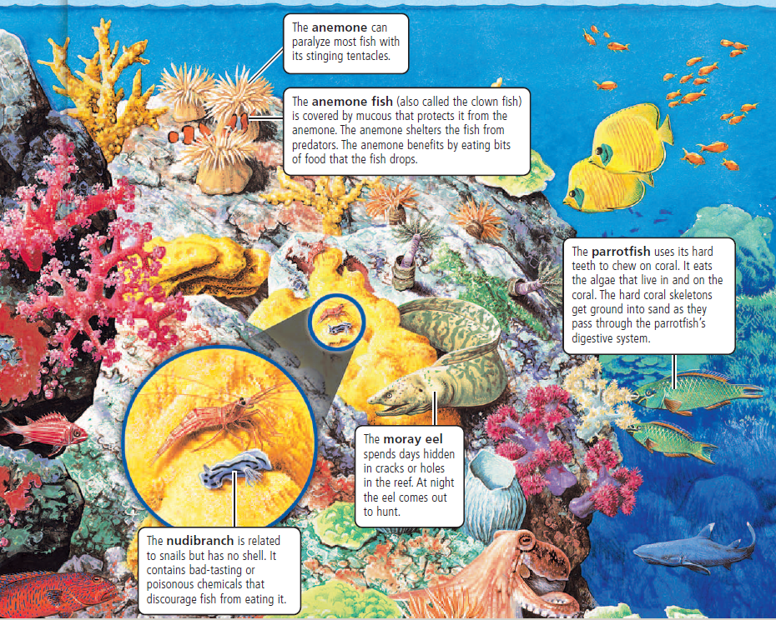

Slide 14
Habitats: Kelp Forests
Found in cold water
Kelp (seaweed) attaches to the ocean floor & grows upwards (can be 40 meters tall!); have air bulbs on the stalks to help it float up towards the surface
Use sunlight to produce food
Found near shore (need sunlight)
Provide habitat for many organisms

Slide 15
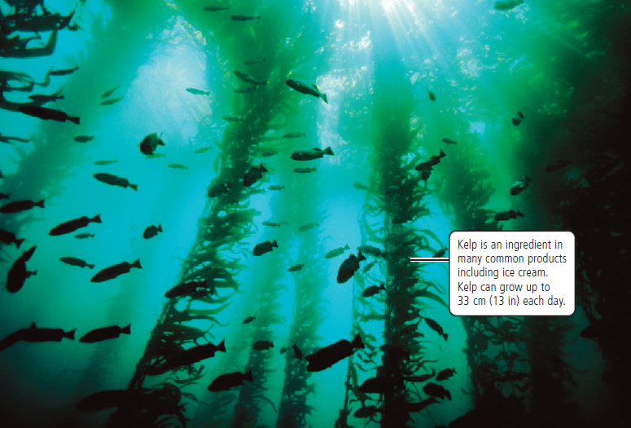

Slide 16
Habitats: Open Ocean
Oceanographers (scientists who study the ocean) divide the ocean into zones according to how far down sunlight penetrates
  Surface zone: also known as the sunlit zone or photic zone; the part of the ocean that sunlight can penetrate. All marine plants live here because they need sunlight for photosynthesis. Almost all life in the ocean is dependent on plants (remember: Circle of Life)
  Deep zone: deep ocean; completely dark.

Slide 17
Habitats: Surface Zone
Sunlight penetrates here: top 200 meters
contains phytoplankton (tiny plant-like protists that change CO→O): they make most of the oxygen in our atmosphere, and are also an important food source in ocean food chains. They are the most abundant “plants” in the ocean.
  zooplankton—tiny floating animals that eat phytoplankton
  zooplankton and phytoplankton get eaten by fish, squid, and other animals, like whales.
Things that live in the surface zone must keep from sinking
  Phytoplankton bodies have large surface areas
  Many fish have an air-filled organ called an air bladder—helps fish change depth; fill with air = float, release air = sink

Slide 18
Habitats: Deep Ocean
under surface zone
no sunlight = no plants (cold and dark)
We used to think that no life could exist in the deep ocean, but it contains extremophiles, including some fish, squid, shrimp, crabs
  Extremophiles: organisms that can live in areas with extreme pressure, temperature, complete darkness, and toxic chemicals
  No plants for food—deep-sea animals eat each other or rely on food drifting down from the surface
  Bioluminescence: when animals glow in the dark—many deep-sea animals do this (fireflies do too).
Discovering life in the deep ocean revised our thinking about what organisms need to live; it expanded our understanding of how life evolved and how life might exist on other planets
most of deep zone is unexplored due to pressure, darkness, & size

Slide 19
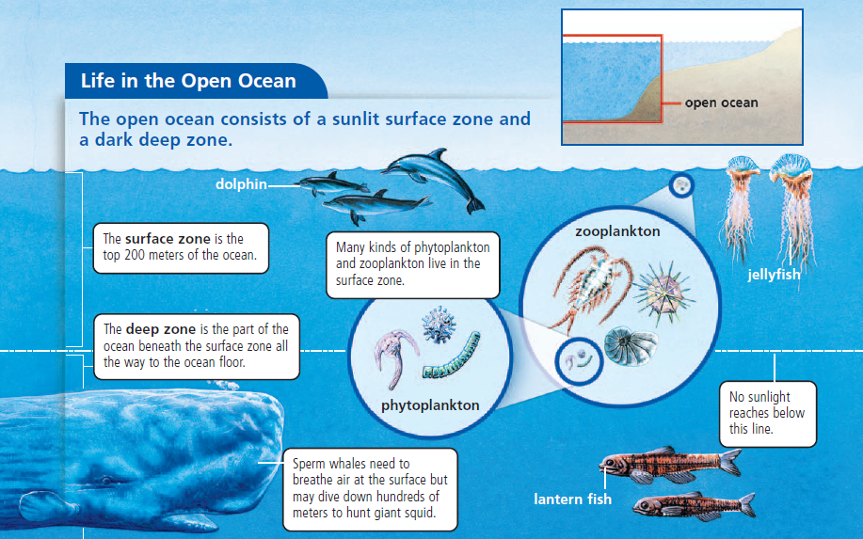
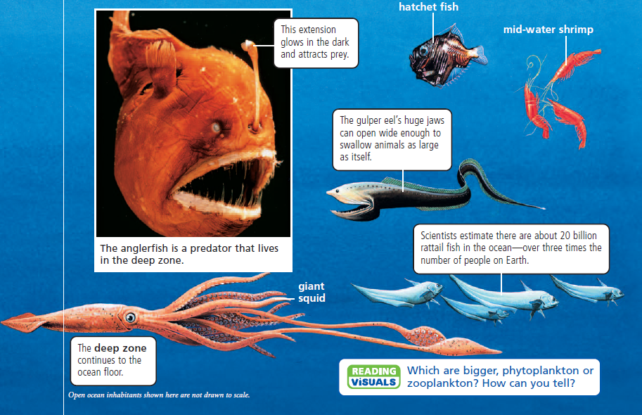

Slide 20
Habitats: Hydrothermal Vents
lots of organisms live near hydrothermal vents
  Driven by volcanoes under the ocean
  cracks in Earth’s crust→water seeps into cracks, heats up, rises back up, rushes out of cracks
    The water coming back up from the cracks contains chemicals
  animals that live near vents depend on a special bacteria—make food from chemicals released by the vents (like sulfur)
  Vents and the organisms that live there are created and destroyed as volcanic activity in the area changes (may be a few decades, or hundreds of years)

Slide 21
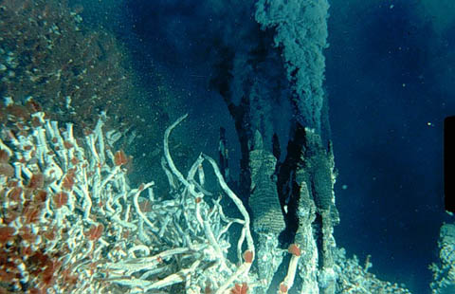
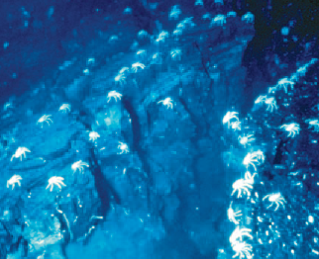
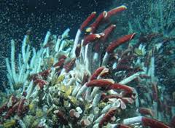

Slide 22
Habitats: Cold Seeps
Cracks in the Earth from which cold fluids come out
  Fluid usually composed of natural gas (methane) and hydrocarbons
    Microbes can process methane to make food; base of the food chain at cold seeps
  Fluid comes out at slower rate than hot fluid at hydrothermal vents
    lasts for longer periods of time; some seeps may be thousands of years old

Slide 23
How can scientists study the deep ocean?
From ships:
  Photograph the bottom: use SONAR—sound waves that map the ocean floor
  Drop floats into currents to map currents
  Collect samples of water, rock, and marine life
New technology:
  Submersibles (submarines), remote-controlled vehicles, robots

Slide 24
What is a food chain/web?
Food Chain: how energy travels through an ecosystem—shows what organisms eat.
Food Web: a more intricate food chain; animals usually don’t eat only one thing, and most things are eaten by more than one type of animal.
  Example: Kelp→Sea Urchins, Fish→Sea Otters, Sea Lions→Killer Whales, Sharks
Most marine creatures eat a variety of foods. If one link in a food chain is gone, there are alternate food sources
Ocean food chains/webs are also connected to land organisms (bears may eat fish, dead things on beach, raccoons may eat shelfish, etc.)

Slide 25
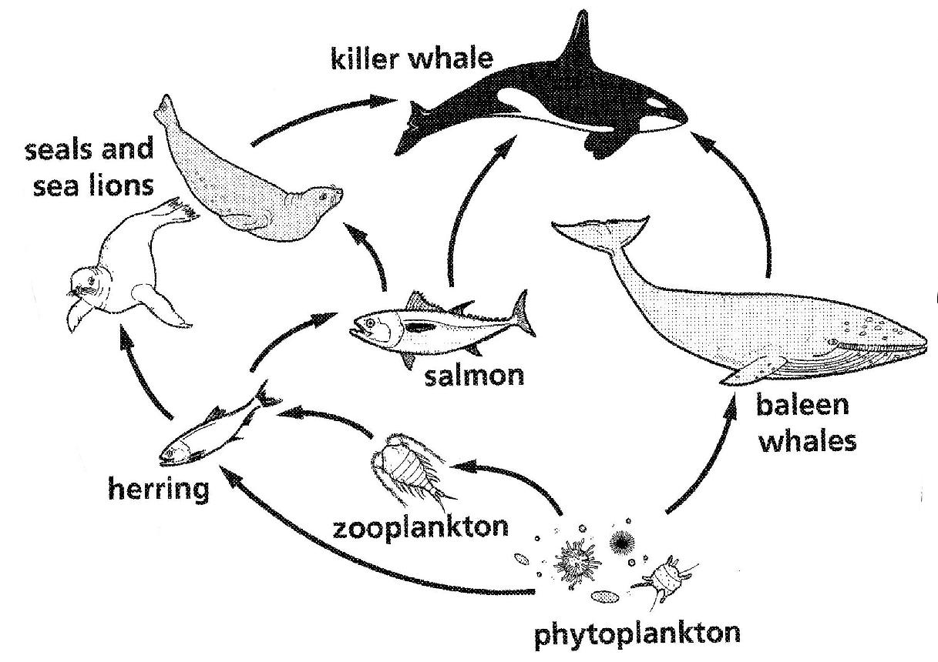

Slide 26
What do food chains look like in the deep ocean?
Because sunlight doesn’t reach the deep ocean (including hydrothermal vents and cold seeps), microbes have evolved chemosynthetic (using chemicals to make food) processes that create food by reacting oxygen with chemicals (like sulfur and methane) in the water around hydrothermal vents and cold seeps.
  Some animals (like tubeworms) allow these chemosynthetic microbes to live on/in them, providing a habitat for the microbes in exchange for their nutrients
  Some animals (like clams, mussels, snails, and shrimp) eat the microbes.
Most animals that live in the deep are carnivores, and they eat other animals or dead things that sink to the bottom from the surface.

Slide 27
What is a keystone species?
Keystone Species: a species that has a greater-than-expected effect on an ecosystem; if it is removed from the environment, the entire ecosystem is affected dramatically (sometimes, it completely “collapses”).
  Many keystone species are top predators (killer whales, starfish, wolves, bears)
  Example: In the food web above, killer whales are the keystone species. If they are removed from the environment, there will be too many salmon, which will provide more food for the seals and sea lions who’s population will increase, then seals and sea lions along with salmon will eat all of the herring, which will lead to too many zooplankton, which will eat all of the phytoplankton, which will lead to not enough food for the baleen whale (and less oxygen).

