Slide 1
Notes: Geology Chapter 1

Slide 2
How did the Earth form?
4.6 billion years ago, bits of material collided and stuck together
Heat from impacts heated the material up and Earth melted into ball of rock
Denser “heavier” materials/elements (iron, nickel) sank toward center
Less dense “lighter” materials/elements stayed on surface
Formed 3 main layers:
the core (heavy stuff)
the mantle
the crust (light stuff)

Slide 3
What are the 3 layers of the Earth?
The Core
Densest “heaviest” region in the center of Earth
Made of 2 parts:
Inner core: ball of very hot solid metals—high pressure keeps metals from melting
Outer core: liquid metals surrounding the inner core—lower pressure allows metals to be liquid
The Mantle
Thickest layer (1700 miles thick), less dense (“lighter”) than the core
the very top is cool and rigid (doesn’t move), but right below that the mantle rock is hot and soft enough to move very slowly
The Crust
Thin, cool; surrounds Earth like a shell surrounds an egg
ranges in thickness (different depending on where you are)
2 types of crust
continental crust (land, thick, but less dense)
oceanic crust (ocean floors, thin, but more dense)
The crust is where ALL life on Earth lives

Slide 4
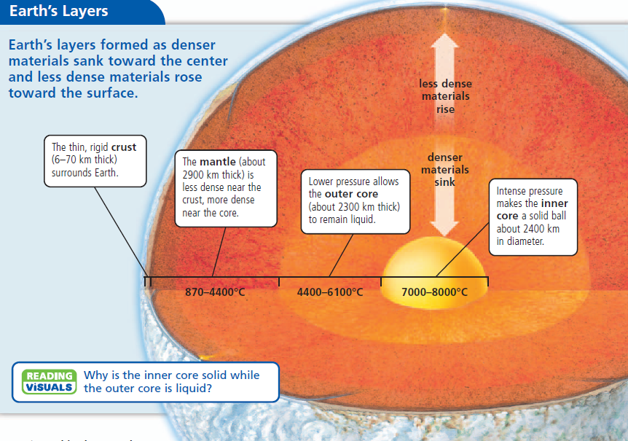

Slide 5
How do we know what the interior of Earth looks like?
Study the energy from earthquakes or underground explosions that scientists set off
Energy moves slower through less dense materials and liquids, and faster through more dense materials and solids.

Slide 6
What are the lithosphere and asthenosphere?
Lithosphere = Earth’s Crust + rigid top of mantle—most rigid layer
Asthenosphere = right under the lithosphere; upper mantle—soft enough to flow like hot tar
Lithosphere is broken into large pieces, called tectonic plates
Can be large or small
Plates fit together like jigsaw puzzle
Contain both continental and oceanic crust

Slide 7
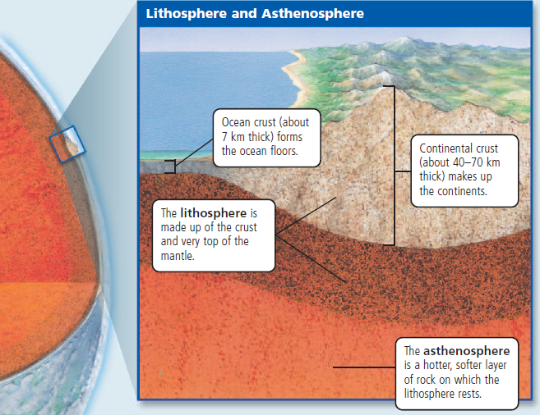

Slide 8
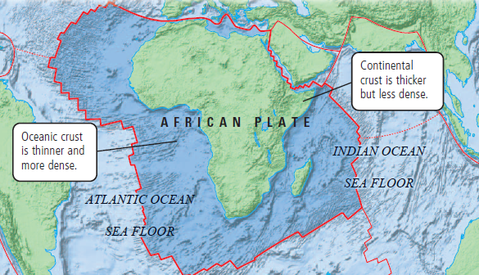
The African Plate

Slide 9
What is continental drift?
Alfred Wegener (German) proposed continental drift hypothesis in 1912
Says that continents were once joined, but gradually drifted apart
Continents were once joined in a supercontinent called Pangaea
Pangaea split apart over the last 200 million years.
People didn’t believe him at first because he didn’t know HOW they moved.

Slide 10
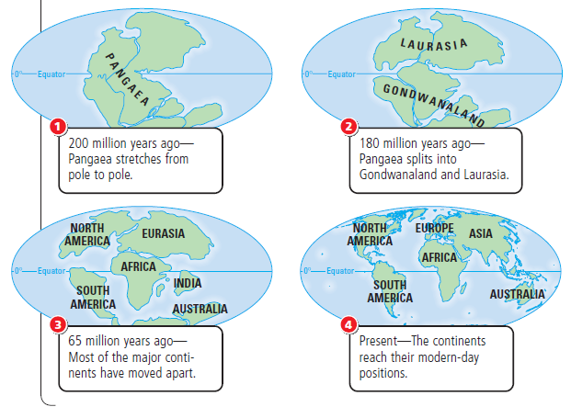

Slide 11
What evidence do we have that continents move?
EVIDENCE from fossils, climate, and rocks
Same fossils:
Example: In both South America and Africa, a small, ancient reptile’s fossils were found, but nowhere else in the world. Could be explained if S. America and Africa were once joined.
Climate changes
Example: Greenland is near the arctic circle (near north pole), but it has fossils of tropical plants.
Example: South Africa is very warm, but its rocks have scratches made by ice sheets.
Same rock types in Brazil and West Africa. Also, limestone layers in the Appalachian Mountains of North America that are exactly like the limestone in Scotland’s Highlands.

Slide 12
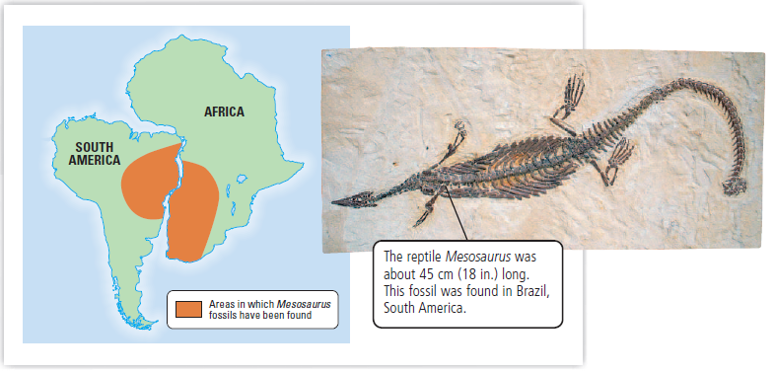
Fossils found:

Slide 13
Evidence in the oceans:
Ocean floor was studied in 1950s—found mid-ocean ridges
Found in every ocean
Sea-Floor Spreading occurs at MORs
MORs form along cracks in the crust
Molten (liquid) rock oozes through the cracks and cools to form new crust
Age of the sea floor:
Rock samples show that youngest rock is closest to the ridge, while older rocks are farther away.
Ocean floor forms and moves away from mid-ocean ridges like a conveyor belt, moving the tectonic plates and their continents with them.
Ocean Trenches:
Oceanic crust sinks into the Asthenosphere at ocean trenches. Old crust is destroyed at the same rate that new crust is forming.

Slide 14
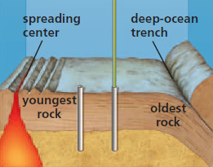

Slide 15
Why do plates move?
Plates move because of convection.
Rock in the Asthenosphere follows a convection current—a motion that transfers heat energy in materials.
Rock is heated close to the core→Rock becomes less dense (“lighter”)→ Rock rises up→Rock cools down (away from the core)→Rock becomes more dense (“heavier”)→Rock sinks

Slide 17
What is the Theory of Plate Tectonics?
Lithosphere is made of huge plates that move over the surface of the Earth
Lithosphere is moved by:
Convection Currents: Plates are carried on the Asthenosphere by convection currents circulating—happens slowly (over millions of years, plates move thousands of kilometers).
Slab Pull: where gravity pulls the edge of a cool, dense plate into the Asthenosphere—the entire plate is dragged along.
Ridge Push: material from a mid-ocean ridge slides downhill from the ridge—the material pushes the rest of the plate.

Slide 18
What are the major tectonic plates?
There are 9 major tectonic plates: African, Antarctic, Australian, Indian, Eurasian, Nazca, North American, South American, and Pacific plates.
Plates affect each other as they move. They can:
Move apart—Example: South American and African
Push together—Example: Indian and Eurasian
Scrape past each other—Example: North American and Pacific

Slide 19
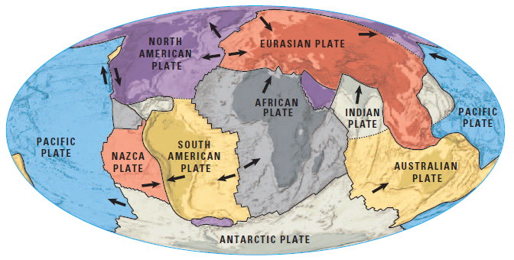
Major Tectonic Plates

Slide 20
What are plate boundaries?
Tectonic plates have different boundaries.
Boundary: where the edges of 2 plates meet
There are 3 types of boundaries.
Divergent: plates move apart
most are found in the ocean
also called spreading centers
Convergent: plates push together
Transform: plates scrape past each other

Slide 21
What is a divergent boundary?
Divergent boundaries: plates move apart ( ← →)
Sea floor spreads at these boundaries and forms Mid-Ocean ridges:
plates move apart, forming a gap in the center (called a rift valley)
Molten material rises from the crack, cold ocean water cools the rock until it becomes solid—forms new sea floor.
Ex. Mid-Atlantic Ridge—longest in the world (6214 miles)
Continents move apart at divergent boundaries
Plates move apart; cracks form in Earth’s crust (forms a rift valley)
Molten rock (hot!) oozes into these cracks
Rift valley gets lower and lower as the continents move farther apart; water can fill in the valley to form a sea or lake
Ex. Great Rift Valley in Africa

Slide 23
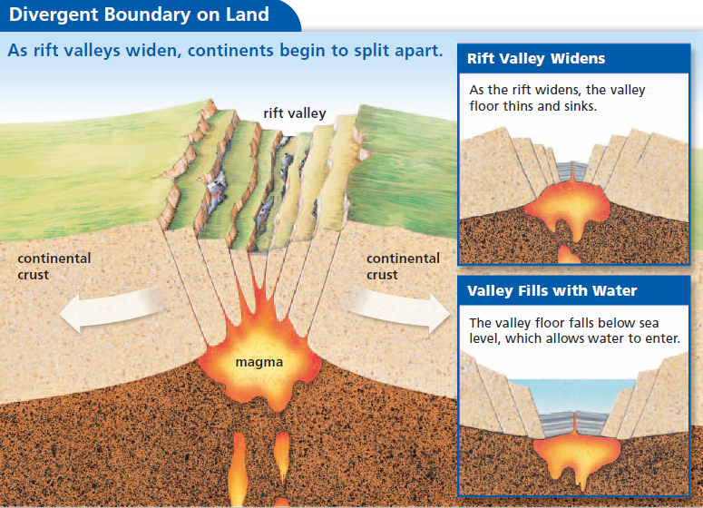

Slide 24
What are convergent boundaries?
Convergent boundaries: plates move together (→ ←)
Plates push together; crust is folded or crumbled (destroyed)—forms MOUNTAINS.
Subduction: when 2 plates push together and one is more dense (“heavier”) than the other, so it sinks under the less dense (“lighter”) plate.
Volcanoes form in subduction zones as magma rises where the plate is melting as it sinks into the hot Asthenosphere

Slide 25
What are the 3 types of convergent boundaries?
Continental-continental collision: 2 plates with continental crust push together
plates have same density, so NO SUBDUCTION
plates will crumble and fold (destroying crust), forming mountains
Ex. Himalayas (Mt. Everest), Alps—still growing today
Oceanic-oceanic subduction: older plate (more dense) with oceanic crust sinks below newer plate
Forms ocean trenches
Oceanic-continental subduction: plate with oceanic crust is more dense so it sinks below plate with continental crust, which is less dense
2 main features: ocean trenches and coastal mountains
As ocean crust sinks under a continent, continental crust buckles and forms a range of mountains—some of the mountains are volcanoes, as melted oceanic crust rises through the plate.

Slide 28
What are transform boundaries?
Transform Boundaries: plates scrape past each other
Crust is neither formed nor destroyed—plates move past each other in opposite directions.
As they move, their edges scrape and grind against each other, causing earthquakes
Mostly occur near mid-ocean ridges, but also occur on land, where they are clearly visible as cracks along the surface.
Can move rivers and roads so they look crooked.
Example: San Andreas Fault in California—where N. American plate and Pacific plate are moving in opposite directions—it’s why CA has lots of earthquakes.

Slide 29
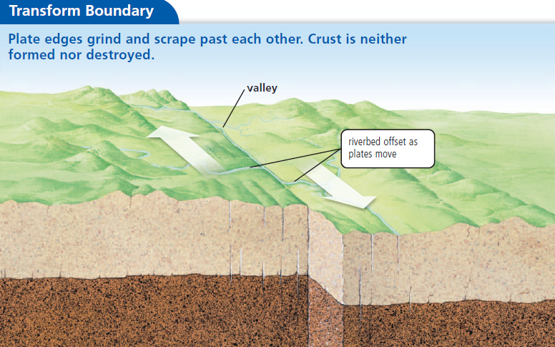

Slide 30
What are hot spots?
Hot spot: hot rock that rises in thin columns from the mantle. They can track plate movement in oceans
Causes underwater volcanoes that may become tall enough to form an island.
Hot spots never move—the plate moves above the hot spot
Used to measure speed and direction of plate movement
Ex. Hawaiian Islands—formed as Pacific plate moves over a hot spot. The largest island, Hawaii, is still over the hot spot.

Slide 31
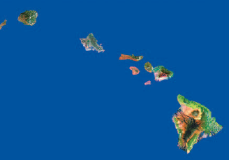

Slide 32
What are faults?
Fault: a crack in Earth’s crust.
Faults generally occur at tectonic plate boundaries where plates are moving
2 main types of faults:
Dip-slip: 2 pieces of land move vertically to each other, so one side of the fault is higher than the other.
Strike-slip: 2 pieces of land move horizontally

