Slide 1
Evolution Chapter 1

Slide 2
Early Life on Earth
3.8 billion yrs ago, all organisms lived in the ocean
Fossils provide evidence of life
Many different types
Age = relative age (layers) and absolute age (radioactive dating).
fossil record: info about fossils in a certain area
can show periods of time when certain species lived and died

Slide 3
More Complex Organisms Developed over Time
Development of complex organisms is in fossil records
Unicellular organisms: one-celled organisms
Some produced oxygen, which put more oxygen into our atmosphere (early on, there was very little oxygen)
Multicellular organisms: more than one cell
arrived in the ocean ~ 1.2 billion yrs. ago
cells perform different tasks (specialization)
earliest were tiny seaweeds

Slide 4
Life On Land
Without water, living things can’t survive
Life moved from the ocean to land about 500 million years ago, but still needed water
first land-dwelling organisms were simple plants (with roots to absorb water) and fungi
Insects—plants provided them food and shelter, then amphibians and reptiles, then birds and mammals evolved.

Slide 5
Stop and Think
Describe the first life on Earth in 3 words.
How do we know the progression of life on Earth?

Slide 6
Earth’s History Includes Mass Extinctions
mass extinction: period when huge numbers of species die/become extinct in a short time
many have happened, but there are 2 main mass extinctions:
Permian Extinction
~ 250 million years ago, ~ 90% of ocean life and most land animals disappeared
Pangaea formed, which would have changed climate and water conditions—this could have caused the extinction
Scientists also think the extinction could have been caused by volcanic activity.

Slide 7
Mass Extinctions: Cretaceous Extinction
~ 65 million years ago, fossil records for dinosaurs and more than 50% of other species living on Earth stop.
Many scientists think that a large meteorite collided with Earth, and this is what caused the extinction—there is a crater off the coast of Mexico from a meteorite impact, and fragments of the meteorite have been found in the area.
Afterwards, new species developed and flourished

Slide 8
Scientists Explore the Concept of Evolution
Evolution: the process through which species change over time.
Evolution results from a change in the genetic material of an organism and is passed from one generation to the next.
The first scientist to propose a model of how life evolves was Jean Baptiste de Lamarck.
He based his model on the fossil record.
He said that an organism can acquire a new trait during its lifetime and pass it along to its offspring.
Ex. Giraffes (long necks were a result of stretching to reach leaves)
His theory had no evidence to support it and was discredited (he was wrong). However, in the last few years, scientists have found evidence that certain things can affect our genome without changing our actual DNA (epigenetics).

Slide 9
Charles Darwin
He was a British naturalist that traveled with the British navy for 5 years, observing plants and animals in South America (the Galapagos), Australia, and Africa (Madagascar).
He compared new animals he saw with ones from England.
On the Galapagos Islands, plants and animals not only differed from those he saw on the mainland, but sometimes differed from island to island.
Some organisms he studied include tortoises and finches (birds).
He said living things evolve through natural selection.

Slide 11
Stop and Think
If humans were to die out in 2016, would you consider this a mass extinction? Why or why not?
Summarize the history of the theory of evolution.

Slide 12
Natural Selection
Natural Selection explains how living things evolve.
After Darwin analyzed his findings, he developed his hypothesis by 1844. His hypothesis is based on a process called artificial selection, in which organisms that have certain desired traits are allowed to mate with other organisms.
Example: Different breeds of dogs
In nature, a process called natural selection occurs. In natural selection, members of a species that are best suited to their environment survive and reproduce at a higher rate than other species’ members.
Natural selection is based on 4 key principles: overproduction, variation, adaptation, and selection.

Slide 13
Overproduction
Overproduction occurs when a plant or animal reproduces, it usually makes more offspring than the environment can support. This is to ensure that some of the offspring will survive long enough to grow into an adult and reproduce.
Ex: Salmon lay thousands of eggs, but only a few dozen live to adulthood

Slide 14
Variation
Within a species, there are natural differences, or variations, in traits. These variations resulted from a change in the genetic material, known as a mutation.
The more genetic variation there is in a population, the more likely it is that some of the individuals will survive if the environment changes.
Genetic variations are passed on from parent to offspring.
Ex: A mutation might cause a fish to have a curved tail

Slide 15
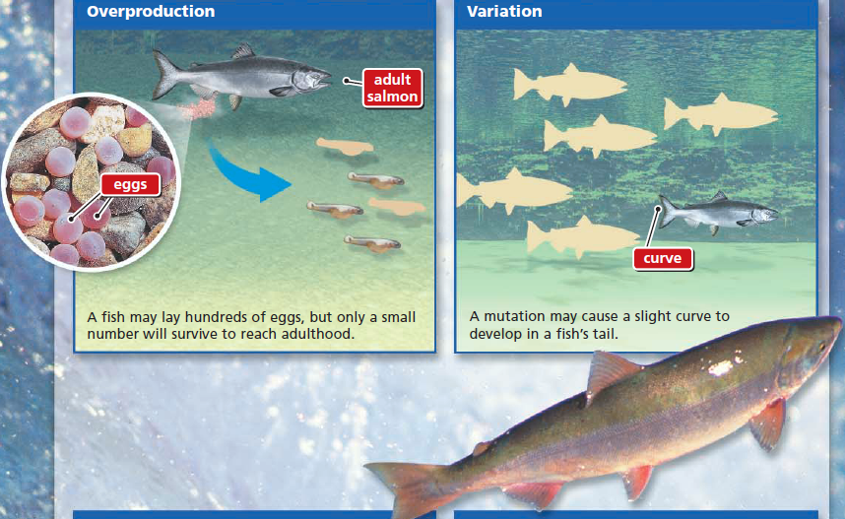

Slide 16
Adaptation
An adaptation is any inherited trait that gives an organism an advantage in its particular environment.
Ex: Changing the tail shape of a fish can help it swim faster.

Slide 17
Selection
Darwin concluded that organisms with adaptations would survive long enough to reproduce, causing the adaptation to be more common in the offspring and future generations.
Beneficial adaptations are “selected for” in an environment.
More individuals will show the adaptation from generation to generation.
Ex: over time, fish with curved tails make up the majority of a group of salmon.

Slide 18
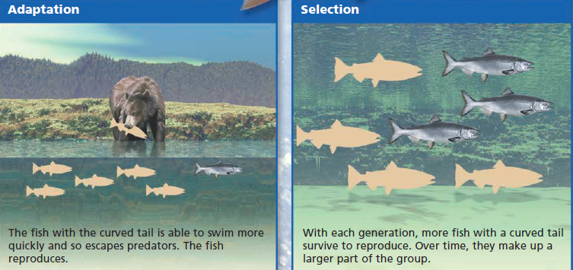

Slide 19
Summarize the Theory of Evolution:
Darwin’s Theory of Evolution says that living things change (or evolve) in response to changes in their environment.
All life is related and descended from a common ancestor. New species develop from older species.
Organisms change through natural selection: random genetic mutations occur within an organism’s DNA, and the helpful mutations become more common because they aid survival and so are passed on to the next generation. Over time, helpful mutations accumulate and you end up with an entirely different organism.

Slide 20
Isolation and Speciation
Speciation is the evolution of new species from an existing species. This can occur when the environment changes dramatically or gradually.
Isolation can cause many new species to evolve. Isolation of a species’ populations can contribute to speciation.
Isolation prevents populations from interacting. As a result, genetic differences (variations) begin to add up in the isolated population.
Isolation leads to speciation.
A geographic boundary like an ocean or mountain range can result in isolation.

Slide 22
What is a theory?
Observations provide evidence for theories
Everyone makes observations; observations can lead to theories
Scientific theory: a widely accepted statement based on observations and experiments that explains a group of facts.
3 types of evidence that support evolution: Fossil, Biological, and Genetic

Slide 23
Fossil Evidence:
Fossils can show us how species are related
Geographic information about fossils provides evidence that two species with a common ancestor can develop differently in different locations.
Compare organisms that live today to organisms that lived in the past.
You can also see small changes in organisms through the rock layers and fossil record.
Transitional fossils: fossils that show the link between one organism and another.
Ex: Archyaeopteryx: a fossil of a lizard-like organism with feathers shows the link between dinosaurs and birds.
Ex: Tiktaalik: a fossil of a fish that had leg bones in its fins and had both lungs and gills. Shows the transition from sea to land.
Ancestor: an early form of an organism from which later forms descend
Scientists comparing modern plants/algae and fossils of plants/algae can tell they share a common ancestor.

Slide 24
Fossil Evidence

Slide 25
Biological Evidence
Scientists are still studying animals in the Galapagos that Darwin observed; they are able to follow and record evolutionary changes as they are unfolding.
Antibiotic resistance in bacteria is evidence of evolution; bacteria have evolved to be resistant
Helps to identify relationships between organisms
Includes the structure and the development of organisms
2 types of structural evidence: vestigial organs and homologous structures

Slide 26
Biological Evidence: Vestigial Organs
Vestigial organs: physical structures that were used and developed in an ancestral group of organisms but are present but aren’t used in later organisms.
Ex. Humans have the remnant of a “tailbone,” suggesting our ancestors had tails.
Ex. Snake skeletons and bodies of whales have traces of leg-like structures.

Slide 27
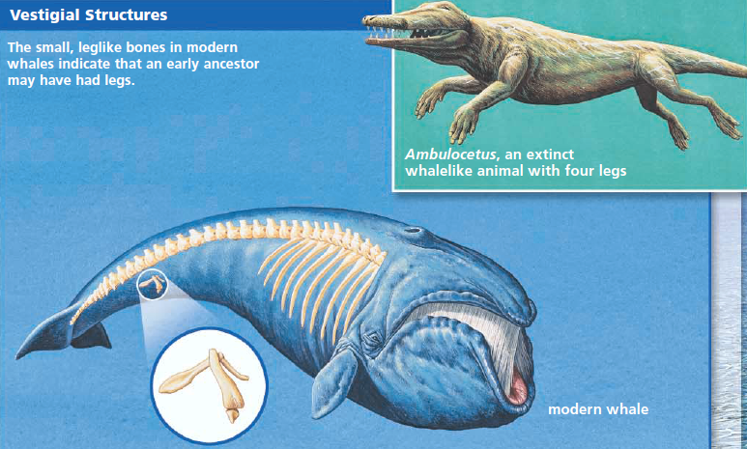

Slide 28
Biological Evidence: Homologous Structures
Homologous Structures: similar body structures with different functions
Scientists studying anatomy of living things have noticed that many species share similar structures, but that these structures are used differently by each species (they have different functions)
Indicates that organisms have a common ancestor with that structure
Ex: leg/forearm bones of lizards, bats, whales, cats, and humans all have the same pattern of one bone → two bones → lots of bones.

Slide 29
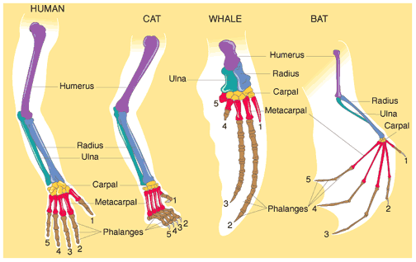

Slide 30
Biological Evidence: Development
In the early stages of development (embryo), organisms look similar.
Look more different as they continue to develop and age
Evidence of a common ancestor
Ex. Chicken, rabbit, salamander, pig, and human embryos all have similarities
Scientists have found that many of the genes that control fundamental steps of embryonic development — such as those that differentiate the front from the back of an organism, or those that lay out the pattern of digits on a limb – are the same/similar among many animal species.

Slide 32
Genetic Evidence:
DNA: genetic material found in all living things on Earth.
passed on to offspring
made up of bases (G, C, A, T)
gene: segment of DNA that codes for a trait or function—each gene has a particular sequence of bases.
Studied to see how closely related some organisms are.
The more matches there are in the sequence of bases between two organisms, the more closely related they are.
Ex. Human and mouse
Almost all genes found in a mouse are also found in humans
sleeping pattern/clock genes are very similar
Pseudogenes: remnants of genes that no longer function. Humans have “pseudogenes” that have no function for us, but that are very similar to genes in other animals that DO have a function.
Ex: We have pseudogenes that are very similar to genes that produce yolk in egg-laying organisms. This suggests that we evolved from organisms that laid eggs.

