Slide 1
Evolution Notes Chapter 2: Taxonomy and Classification
4/30/14

Slide 2
Scientists classify millions of species
400 years ago, scientists believed that related animals looked alike, and classified animals based upon their appearance and behavior.
Classification and Taxonomy are the two scientific processes that deal with classifying and naming living things.
Classification: the process of arranging organisms into groups based on similarities.
Taxonomy: the science of naming and classifying organisms.

Slide 3
Why is classification important?
A good classification system allows you to organize a large amount of information so that it is easy to find and understand. It should provide a tool for comparing very large groups of organisms as well as smaller groups.
A good taxonomy system allows people to communicate about organisms.
Biologists need both a system for organizing and a system for naming organisms.
To classify organisms, scientists use similarities and differences among species.
A classification system can help you identify unfamiliar organisms.
If two organisms have many similar characteristics, then their names will be similar in the classification system.

Slide 4
Taxonomists study biological relationships
A taxon is a group of organisms that share certain traits.
Taxonomists study the relationships between species to see how species evolved, and species who share ancestors are grouped together.

Slide 5
How do we classify organisms?
Scientists compare characteristics/traits to determine how to classify organisms.
A trait is a characteristic or behavior that can be used to tell two species apart
Ex: size, bone structure
If organisms share a trait, taxonomists try to figure out if they share the trait because they have a common ancestor.

Slide 6
How do we figure out how closely related species are?
Taxonomists take evidence and try to reconstruct the evolution of a species, then place the species in the classification system.
Evidence used includes physical evidence (bones, fur, teeth, behavior) and genetic evidence (looking at DNA).
Physical evidence helps scientists see that all living organisms are related through evolution.
Genetic evidence usually supports physical evidence, but not always.
Ex: Pandas: Red Panda=genetics shows it’s more similar to a raccoon, Giant Panda=more similar to bears.

Slide 7
Carolus Linnaeus
Carolus Linnaeus developed system for both naming species and organizing them into groups.
Linnaeus named 4000 species of plants and animals; today we have named over a million species

Slide 8
Naming Species
Scientists used 2 words to name organisms
Genus: a group of species that have similar characteristics; members of the same genus are closely related.
Binomial nomenclature: the system for naming species (Genus species)
Binomial= “two names”
Nomenclature= “list of names”
Most scientific names are Latin words
This is the basis of modern taxonomy.

Slide 9
Using Scientific Names
Binomial nomenclature made communication about certain species much easier.
Rules:
The genus name comes first; the first letter is CAPITALIZED and the entire name is in italics.
The species name is also written in italics , follows the genus name, and the first letter is lowercase.
Example: Chameleo gracilis: a type of lizard called a chameleon.

Slide 10
Organisms can be classified into seven (7) levels
1. Kingdom (most organisms, LEAST specific): Ex: Animalia=animals
2. Phylum: Ex: Chordata=animals with backbones
3. Class: Ex: Mammalia: mammals, or furry animals that nurse their young
4. Order: Ex: Carnivora: carnivores, or animals that kill and eat other animals
5. Family: Ex: Felidae: the cat family—all cats (big and small)
6. Genus: Ex: Felis: housecats, cougars, many others
7. Species (least organisms, MOST specific): Ex: catus: all housecats

Slide 11
Kings Play Chess On Fat Green Stools
(Kingdom, Phylum, Class, Order, Family, Genus, species)

Slide 12
Classification Examples:
Classification Hierarchy of housecats: Animalia→Chordata→Mammalia→Carnivora→Felidae→Felis→catus
Classification Hierarchy of humans: Animalia→Chordata→Mammalia→Primates→Hominidae→Homo→sapiens
The more names an organism shares with another organism, the more closely related they are.

Slide 13
Identifying Organisms
Dichotomous keys and field guides help people identify organisms.
Dichotomous key: a tool that asks a series of questions that can be answered in only two ways.
The questions in a dichotomous key gradually narrow down the possible organisms to help you identify the organism.
The questions can be about any trait.
Field guides include paintings or photographs of familiar species and can help identify organisms.

Slide 14
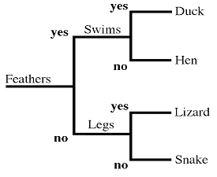
Dichotomous Key Example:

Slide 15
How do we show relationships between species?
Phylogeny: the “family tree” of a species, showing the ancestors of a species and their relationship to other species.
The “root” of the tree shows an ancestor, and the “branches” show descendants.
The place where 2 branches split represents speciation from a common ancestor.
Cladogram: a diagram that shows a phylogeny.
A clade is a group in a phylogeny that includes a common ancestor and all the descendents (living and extinct) of that ancestor. (Imagine clipping a branch off of a tree – that branch plus all of the tiny little branches coming off of it would be a clade.)
Clades may include thousands of species or just a few.
Lineage: the descent in a line from a common ancestor.

Slide 16
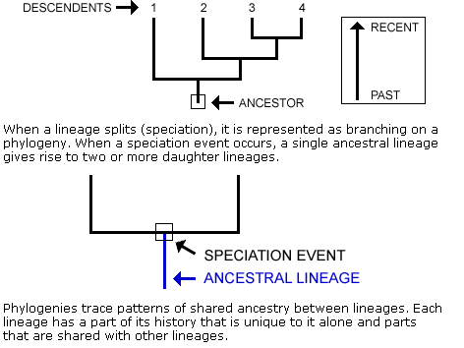
Reading a Phylogeny – Draw

Slide 17
How do we construct phylogenies?
To build a phylogenetic tree, biologists collect data about the characteristics of each organism they are interested in. Characteristics are heritable traits that can be compared across organisms, such as physical characteristics (morphology), genetic sequences, and behavioral traits.
When grouping species, scientists look for shared derived characteristics. A derived characteristic is one that evolved in the common ancestor of a clade and that sets members of that clade apart from other individuals.
Ex: All land animals (not insects) have 4 limbs because they had a distant common ancestor.
Shared derived characteristics can be used to group organisms into clades.

Slide 18
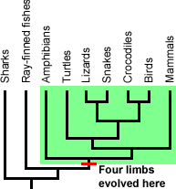
Example:
Amphibians, turtles, lizards, snakes, crocodiles, birds and mammals all have, or historically had, four limbs. If you look at a modern snake you might not see obvious limbs, but fossils show that ancient snakes did have limbs, and some modern snakes actually do retain rudimentary limbs. Four limbs is a shared derived character inherited from a common ancestor that helps set apart this particular clade of vertebrates.
However, the presence of four limbs is not useful for determining relationships within the clade in green above, since all lineages in the clade have that character. To determine the relationships in that clade, we would need to examine other characters that vary across the lineages in the clade.

Slide 19
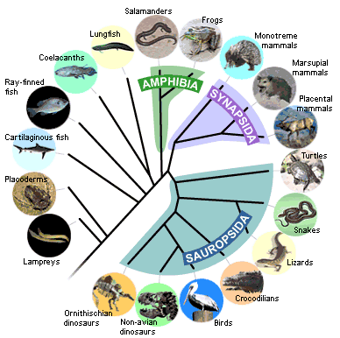
Vertebrate Phylogeny
In order to construct the vertebrate phylogeny, we begin by examining representatives of each lineage to learn about their basic morphology, whether or not the lineage has vertebrae, a bony skeleton, four limbs, an amniotic egg, etc.

Slide 20
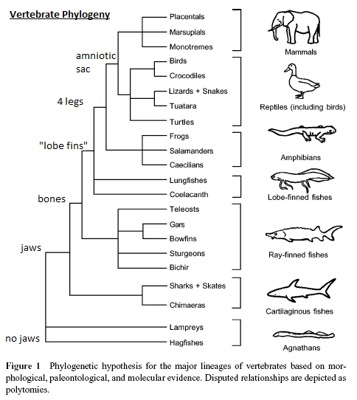

Slide 21
Taxonomy changes as scientists make discoveries
Scientists are learning more about the history of species and how they evolved.
Most scientists use a classification system that has kingdoms, but a new level, called a domain, has been added above the kingdom level.
Domain: the most broad level of a classification system based on cell type
There are 3 domains: Bacteria, Archaea, and Eukarya
Cells that contain a nucleus are called eukaryotic cells; cells that do not contain a nucleus are called prokaryotic cells.
The domain Eukarya contains organisms with eukaryotic cells.
The domains Bacteria and Archaea contain organisms with prokaryotic cells.

Slide 22
Species and environments change
Although over a million species have been named, scientists estimate that there are millions (maybe 10s of millions) that haven’t been discovered.
Species evolve over time as individual organisms and environments change.

