Slide 1
Estuaries
“where the rivers meet the sea”

Slide 2
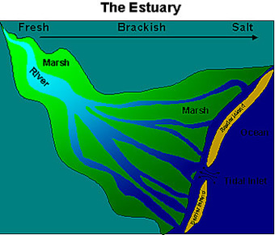
What is an Estuary?
A partially enclosed coastal body of brackish water with one or more rivers flowing into it that connects to the ocean.
Brackish water is a mixture of fresh and saltwater.

Slide 3
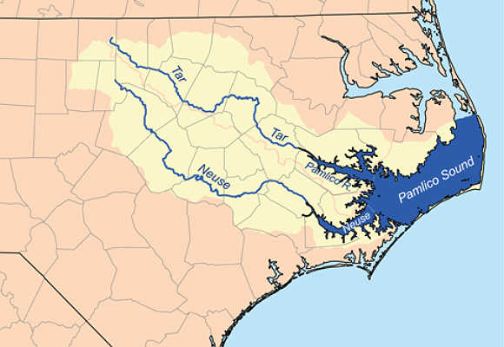
NC Estuaries
The largest estuary in North Carolina is the Pamlico Sound.

Slide 4
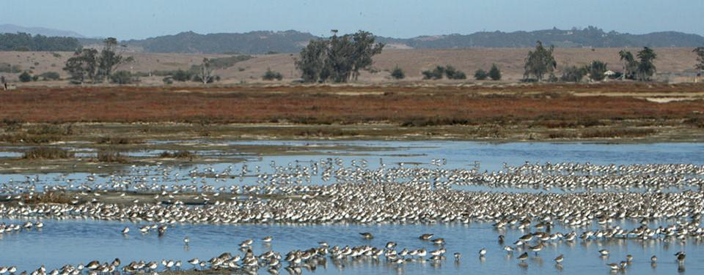
Why are Estuaries Important?
Estuaries trap sediment and nutrients traveling from the land by rivers and from the oceans brought in by the tides.
Estuaries are one of the most diverse and productive ecosystems in the world.

Slide 5
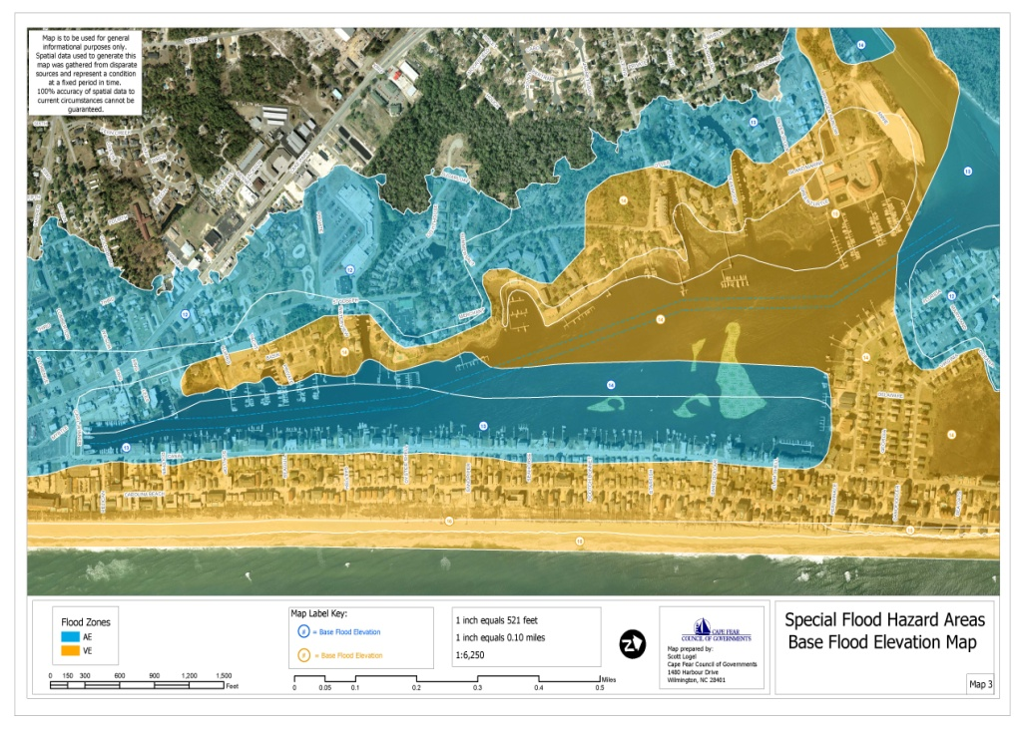
Estuaries as a Resource
Humans harvest seafood from Estuaries.
Humans rely on Estuaries to protect the coastline during storms and to reduce flooding inland.

Slide 6
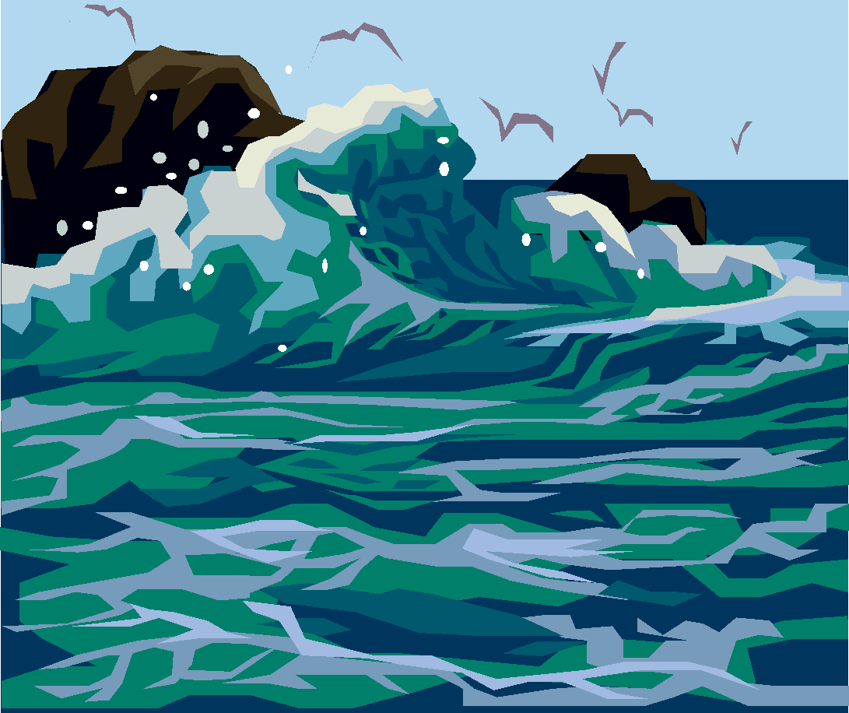
The Ocean

Slide 7
Why is the Ocean important?
For so many reasons…
A speech given by John F. Kennedy, Jr. sums it up well, so much so that Carnival Cruise Lines used his speech in their 2015 Super Bowl Commercial.
http://www.washingtonpost.com/blogs/style-blog/wp/2015/02/02/carnival-cruises-quotes-jfk-in-super-bowl-2015-commercial/

Slide 8
Salinity
Salinity - The total amount of dissolved salt in a sample of water.
How much of the water in the Ocean is salt?

Slide 9
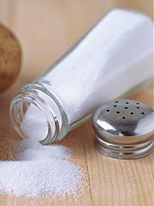
Salinity
Salinity - The total amount of dissolved salt in a sample of water.
How much of the water in the Ocean is salt?
Only 3.5%

Slide 10
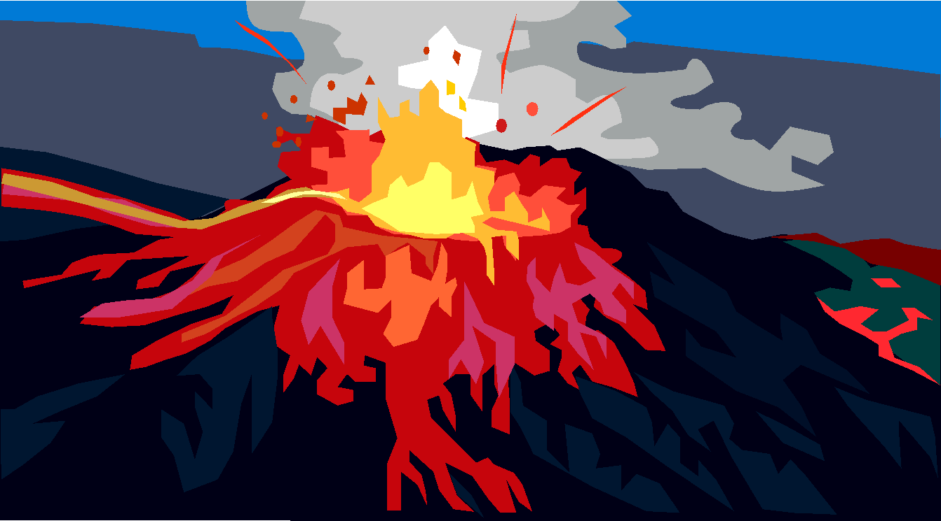
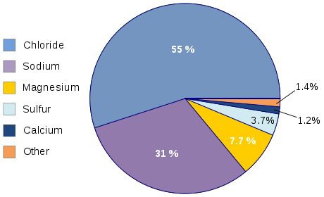
Where does the salt come from?
Volcanic Activity and Land Erosion add many different minerals to the ocean.
These minerals are mostly Sodium and Chloride, and
when combined make salt!

Slide 11
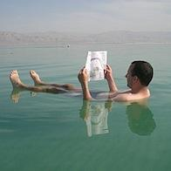
Effects of Salinity
Salinity lowers the freezing point of water.
Salt water takes longer to freeze than fresh water!
Salinity increases the density of water
It is easier to float in salt water than in fresh water!

Slide 12
Effects of Salinity Egg Demo
Egg in Salt water vs. Egg in Fresh water
Make your predictions:
What will happen when an egg is placed in Fresh water?
What will happen when an egg is placed in Salt water?
What does this tell us about the density of salt water in comparison to fresh water?

Slide 13
Dissolved Gases in the Ocean
What 2 gases are found in the air AND in the ocean?

Slide 14
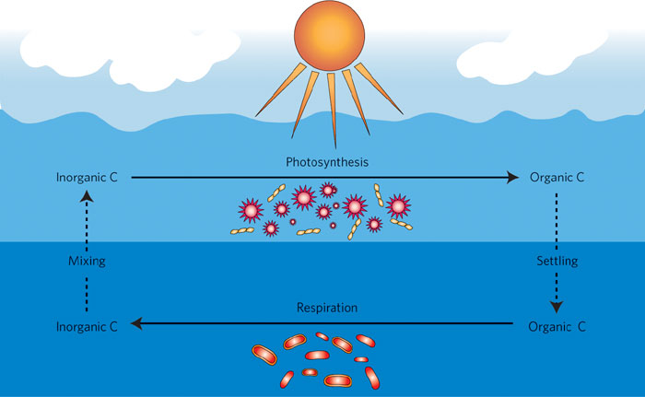
Dissolved Gases in the Ocean
What 2 gases are found in the air AND in ocean water?
Oxygen and Carbon Dioxide

Slide 15
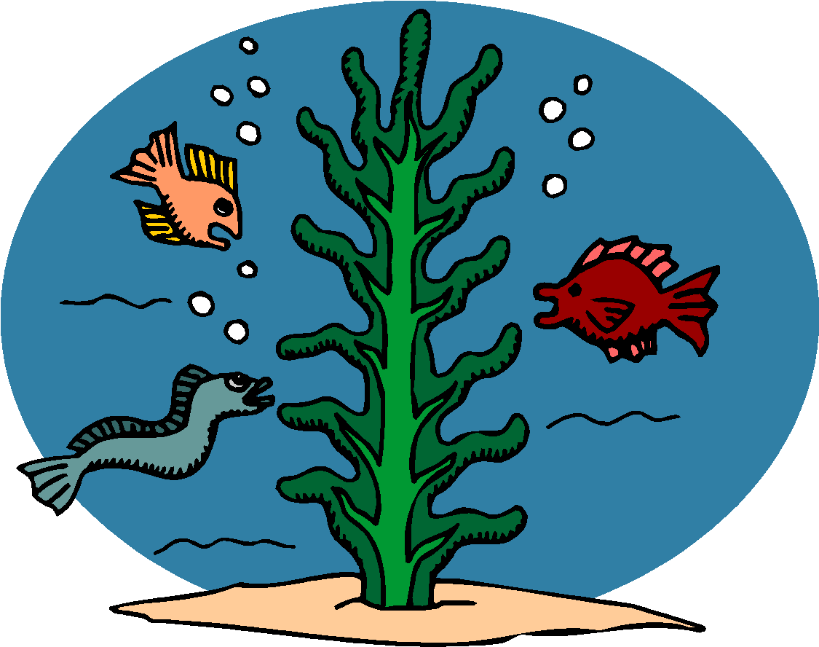
Dissolved Gases in the Ocean
What is the SOURCE of Oxygen in the Ocean?
What is the SOURCE of Carbon Dioxide in the Ocean?

Slide 16
Gases in Ocean Water
What is the SOURCE of Oxygen in the Ocean?
Plants and the Atmosphere
What is the SOURCE of Carbon Dioxide in the Ocean?
Animals and the Atmosphere

Slide 17
Changes with Depth
How do each of the properties change as you go deeper in the ocean?
Temperature?
Light?
Salinity?
Density?
Pressure?

Slide 18
Changes with Depth
How do each of the properties change as you go deeper in the ocean?
Temperature? Decreases
Light? Decreases
Salinity? Stays relatively the same
Density? Increases
Pressure? Increases

