Slide 1
Compounds and Mixtures
Notes:
*

Slide 2
What is a Pure Substance?
A pure substance is a type of matter that includes both elements and compounds
Pure substances cannot be separated by physical means such as
Distillation: boiling a liquid until it evaporates (changes to a gas), then condensing it back to a liquid—different substances boil at different temperatures, so we can separate different substances this way.
Filtration: the process of removing solids from liquids (or gases)
Chromatography: a way to separate different substances based on how fast each substance moves through a filter.
Notes:
*

Slide 3
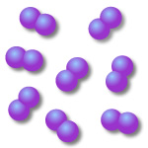
Elements
We have already studied elements
An element is made of one kind of atom
Found on the Periodic Table
Notes:
*

Slide 4
What Is A Compound?
A compound is a pure substance that is created by 2 or more different elements joining together
Ex: NaCl, H₂O, CO₂, NH₃, NaHCO₃, and C₆H₁₂O₆
Notice that elements combine in many different ways to make compounds
Ex: H₂O and H₂O₂, CO and CO₂
Notes:
*

Slide 5
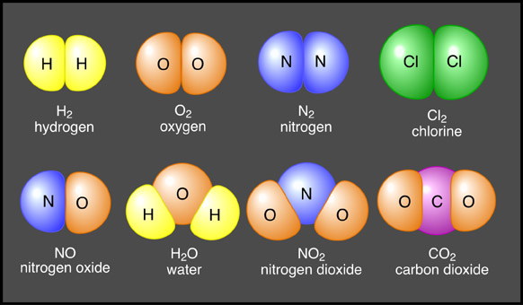
Compounds vs. Elements

Slide 6
Compounds
Compounds have different properties from the elements that they are made of.
Just like letters combine to form words, elements combine to form compounds.
Most substances are compounds, not pure elements.
Atoms are held together by chemical bonds.
Chemical bond: the “glue” that holds atoms together; involves electrons.

Slide 7
Atoms combine in predictable numbers.
Chemical formula: element symbols in a ratio to represent a compound
CO₂ → 1 carbon atom ratio = 1:2
2 oxygen atoms
H₂O → 2 hydrogen atoms ratio = 2:1 1 oxygen atom
Ex. C₂H₄O → ____ carbon atoms
____ hydrogen atoms
____ oxygen atoms
NOTE: we never use the subscript (the number to the right and slightly below the element symbol) 1. We simply write the element’s symbol to show that there is 1 atom of that element in the compound.

Slide 8
Practice Writing Compounds
2 Hydrogen and 1 Oxygen
2. 4 Carbon 16 Oxygen
3. 6 Carbon 12 Hydrogen 6 Oxygen

Slide 9
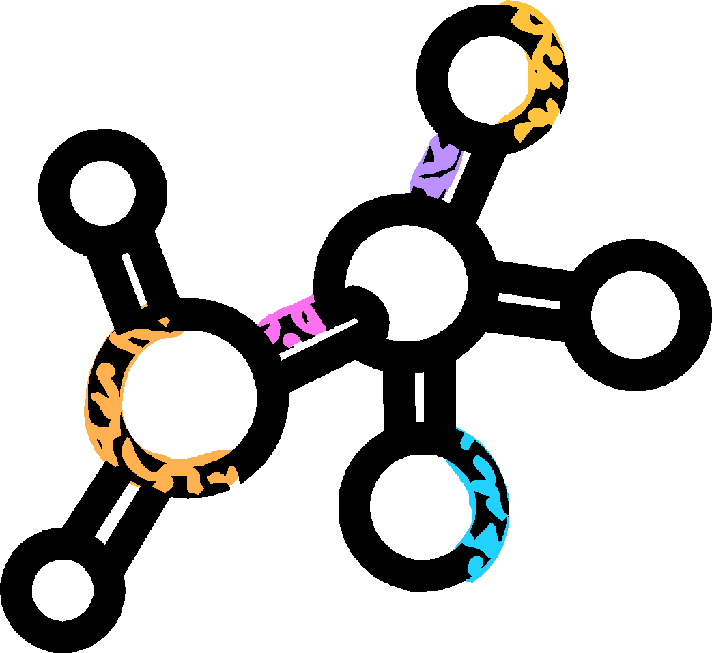
Why Do Compounds Form?
Compounds form to allow elements to become more stable
Na is flammable when it comes in contact with H₂O, and Cl₂ is a toxic gas
NaCl is a very stable compound that is neither flammable nor toxic (in normal quantities)
Compounds that are extremely unstable will break down to form the more stable elements
Notes:
*

Slide 10
How Do Compounds Form?
Compounds form by the interaction between the nuclei and valence electrons of 2 or more elements
THE OCTET RULE: an element is most stable (happy :D) with 8 valence electrons
Elements will join chemically to get 8 valence electrons
Ex: CO₂ : oxygen has 6 valence electrons and carbon has 4
If the carbon shares 2 electrons with each oxygen, everyone will have 8 valence electrons!
Notes:
*

Slide 11
Common Compounds you NEED TO KNOW:
Compounds are used in your everyday life.
H₂O is water
CO₂ is Carbon Dioxide
C₆H₁₂O₆ is glucose, and C₁₂H₂₂O₁₁ is sucrose (both are sugar!)
NaCl is table salt
O₂ is oxygen
NaClO is bleach
HCl is hydrochloric acid
NH₃ is ammonia
NaHCO₃ is baking soda
HC₂H₃O₂ is vinegar

Slide 12
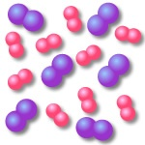
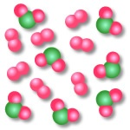
What Is A Mixture?
A mixture is the physical combination of 2 or more substances
It is important to understand that a mixture is not chemically combined
Mixtures can be separated by physical means such as filtration, distillation, and chromatography
Mixtures can be divided into 2 groups
Homogenous mixtures
Heterogeneous mixtures
Notes:
*

Slide 13
How Do Mixtures Form?
Mixtures form by physically putting 2 or more substances together (tea, cake batter, etc.)
Remember: no chemical change is occurring
Notes:
*

Slide 14
What Is a Homogenous Mixture?
A homogeneous mixture is a mixture that’s parts are evenly distributed
Homogeneous mixtures are commonly called solutions.
Solution = Solute + Solvent
Solute: substance (“stuff”) being dissolved
Solvent: substance (“stuff”) doing the dissolving
The solvent is present in greater quantity
The solute is present in the lesser quantity
Ex: Salt water: Salt=solute, Water=solvent
Solute is dissolved in solvent (example: saltwater = salt dissolved in water)
Notes:
*

Slide 15
What Is a Heterogeneous Mixture?
A heterogeneous mixture is a mixture that is unevenly distributed.
Examples:
Iced tea: The ice is floating at the top and therefore is not evenly distributed throughout the tea
Chex Mix: You may find a different number of pretzels or Chex cereal in each handful; therefore, the mixture is unevenly distributed
Notes:
*

Slide 16
Properties change in solutions
A solute changes the physical properties of a solvent
Freezing point
Solvent (water) = 32ºF or 0ºC
Solution (sugar water) = 15ºF or –9ºC
*the freezing point of a solution is lower than the freezing point of the pure solvent*
Example: why do we put salt on a road before it snows?
Boiling point
Solvent (water) = 212ºF or 100ºC
Solution (sugar water) = 225ºF or 108ºC
*The boiling point of a solution is higher than the boiling point of the pure solvent*

Slide 17
The amount of solute that dissolves can vary.
Concentration: the amount of solute dissolved in the solution at a certain temp.
↑ (increase) concentration = add more solute
↓ (decrease) concentration = add more solvent (dilute)
Dilute: less solute is dissolved in solvent
Concentrated: more solute is dissolved in solvent
saturated solution: has as much solute as it can hold at a certain temp.
can’t dissolve any more solute

Slide 18
What is Solubility?
Solubility: the amount of solute that will dissolve in a certain amount of a certain solvent at a certain temperature
every substance has a solubility
High solubility: a large amount of solute can dissolve in solvent
Low solubility: a small amount of solute can dissolve in solvent
Insoluble: solute does not dissolve in solvent at all.
(Ex: oil in water)
the solubility of a solute can be changed
↑ temp = ↑ solubility of solids
= ↓ solubility of gases
↑ pressure = ↑ solubility of gases

