Slide 1
Chemistry Notes: Chapter 1.2 and 1.3: The Periodic Table
Notes:
*

Slide 2
Every element has its own unique symbol.
For some elements the symbol is simply the first letter of the element’s name.
Examples: Hydrogen = H, Sulfur = S, Carbon = C
Symbols for other elements use the first letter plus one other letter of the element’s name. The first letter is CAPITALIZED and the second letter is not.
Examples: Aluminum = Al, Platinum = Pt, cadmium = Cd
The origins of some symbols are not as obvious. Some elements have symbols that refer to the element’s name in latin.
Examples: gold = Au, lead = Pb, copper = Cu

Slide 3
The Father of the Periodic Table—Dimitri Mendeleev
Mendeleev was the first scientist to notice the relationship between the elements
Arranged his periodic table by atomic mass
Said properties of unknown elements could be predicted by the properties of elements around the missing element
Predicted Aluminum (Al)
It was later discovered that the periodic nature of the elements was associated with atomic number, not atomic mass
Periodic means patterns
Notes:
*

Slide 4
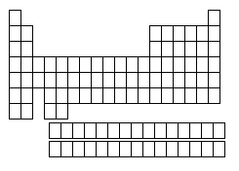
The Periodic Table
Column (up and down)= Group or Family
18 columns on the Periodic Table
Row (side to side)= Period
7 rows on the Periodic Table
Notes:
*

Slide 5
What does the information in the box tell me?
1
H
1.008
Atomic Number = # of protons
Elemental Symbol
Atomic Mass = actual mass of the atom
*if you round, you get Atomic mass Number (# of protons plus neutrons)
Notes:
*

Slide 6
Types of Elements: Metals
On the left side of the periodic table
Properties:
Good conductors of electricity and heat
Shiny in appearance (metallic!)
Malleable: able to be molded or re-shaped
Ductile: able to be stretched into wire or hammered very thin (think: Aluminum foil)
These are general properties; individual properties of metals will vary. Some will be better conductors or more ductile than others!

Slide 7
Types of Elements: Nonmetals
Elements on the right side of the periodic table.
Properties are opposite those of metals.
Usually poor conductors of heat and electricity
Not shiny, malleable, or ductile
Most are gases

Slide 8
Types of Elements: Metalloids
Found touching the “stair-step line” (see next slide)
Have properties of both metals and non-metals.
Most common metalloid is silicon, which is the second most common element in the Earth’s crust.

Slide 9
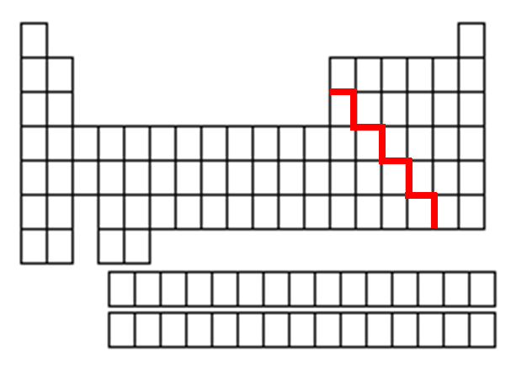
Metals, Nonmetals, and Metalloids
Only
nonmetal on the metal side
Nonmetals are on the right of the stair-step
Metals are to the left of the stair- step
Metalloids touch the stair-step
Notes:
*

Slide 10
Valence Electrons and Reactivity
Valence electrons are the electrons farthest from the nucleus. Atoms have different numbers of valence electrons.
Reactivity: how likely an atom is to interact (react) with other atoms. Some elements are very reactive, while others almost never react.

Slide 11
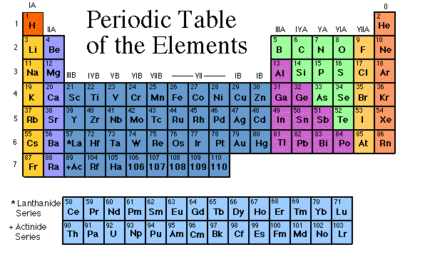
The Groups/Families of the Periodic Table
Elements on the periodic table can be grouped into families (or groups) based on their chemical properties.
We call them “families” because the elements in each family are “related.”
Each family has a specific name to differentiate it from the other families in the periodic table.
Elements in each family
react differently with
other elements.

Slide 12
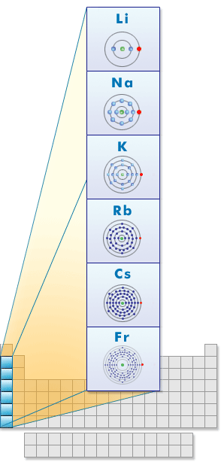
Group 1: the Alkali Metals
Hydrogen is NOT part of this family!!!
Most reactive metals on the PT
Reactive: how likely an atom is to interact with other atoms
Rarely found free (by themselves) in nature
Form ions with a charge of +1, have 1 valence electron
Soft and silvery, shiny
Very reactive, esp. with water
Conduct electricity
Notes:
*

Slide 13
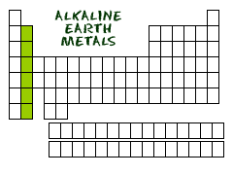
Group 2: the Alkaline Earth Metals
Still quite reactive
Form ions with a charge of +2, have 2 valence electrons
White, silvery, and malleable
Conduct electricity

Slide 14
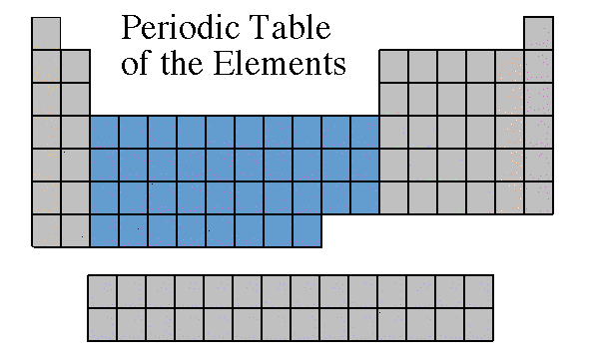
Groups 3-12: Transition Metals
Found freely and in compounds in nature
Form ions with a charge of usually +2 but can vary—usually 2 valence electrons
Almost all are solids at room temp (except Mercury, Hg, is a liquid)
Good conductors of heat
and electricity.
Notes:
*

Slide 15
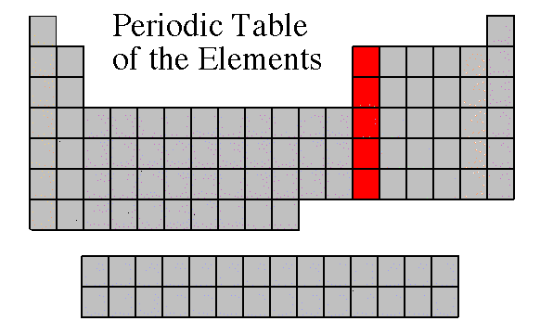
Group 13: Boron Family
Named after the first element in the group (at the top of the column), Boron
Form ions with a charge of +3, have 3 valence electrons

Slide 16
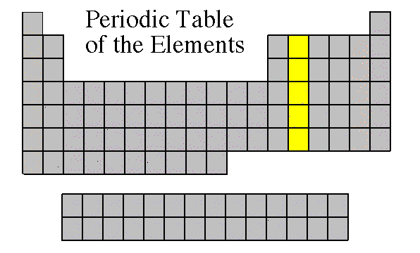
Group 14: The Carbon Family
Contains elements that can form unusual bonds (carbon and silicon)
Form ions with a charge of +4 or -4, have 4 valence electrons
Notes:
*

Slide 17
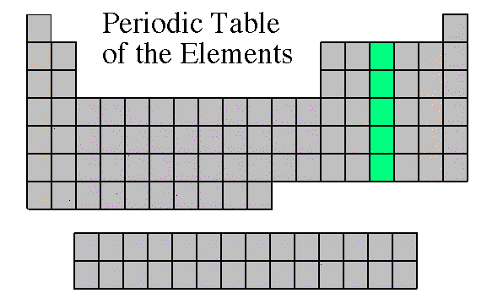
Group 15: the Nitrogen Family
Form ions with a charge of -3, have 5 valence electrons

Slide 18
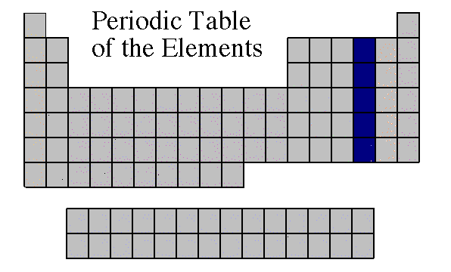
Group 16: The Oxygen Family
Also known as the chalcogens
Form ions with a charge of -2, have 6 valence electrons
Notes:
*

Slide 19
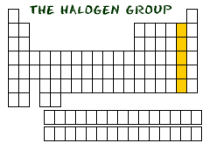
Group 17: the Halogens
Most reactive nonmetals
Form ions with a charge of -1, have 7 valence electrons

Slide 20
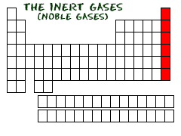
Group 18: The Noble Gases (Inert Gases)
Nonreactive
Do not form ions! Charge is 0, have either 2 or 8 valence electrons
All are gases

Slide 21
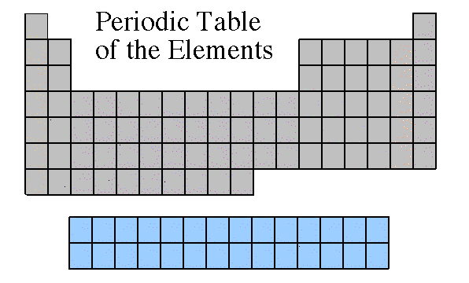
Rare Earth Metals
Some are Radioactive
The rare earths are silver, silvery-white, or gray metals.
Conduct electricity
Lanthanides
Actinides
Notes:
*

Slide 22
Trends in the Periodic Table
Atomic size decreases as you move from left to right across the table. Atomic size increases as you move from top to bottom of the table.
The density of an element increases from top to bottom. The element Osmium has the highest known density.
The most reactive elements are groups 1 and 17. The least reactive elements are in group 18.

Slide 23
Trends in the Periodic Table
Density Increases
Atomic Size Increases
Atomic Size Decreases

